Slide 1
Intro to PCAP
Reid Gilman
Approved for Public Release: 13-0979. Distribution Unlimited

Slide 2
Creative Commons
This presentation is licensed under a
Creative Commons
Attribution-NonCommercial-ShareAlike 3.0
license

Slide 3
This Is Not A Networking Class
It is about problem solving

Slide 4
Goals
Teach problem solving strategies using network analysis examples
Demystify the fundamentals
Know your tools

Slide 5
Syllabus
Day 1
Day 2
1. Why PCAP?
2. Collection Techniques
3. PCAP Storage
4. Berkeley Packet Filter
5. Connectivity Problems
6. Lunch
7. HTTP
8. Chopshop
Unknown Protocols
DNS
Lunch
Final Exercise

Slide 6
Why PCAP?
(a.k.a. Who Cares?)

Slide 7
What Is PCAP?
PCAP == Packet Capture
Complete record of network activity
Layers 2 – 7
Most common format is libpcap
Open-source
Available on *nix and Windows
C library, bindings in many languages
Others proprietary formats not covered
Notes:
libpcap: http://www.tcpdump.org/

Slide 8
Pop Quiz!
Who Remembers The OSI Model?
7
Application
6
5
Session
4
3
2
1
Presentation
Transport
Network
Data Link
Physical
Notes:
Some discussion questions to make sure that students are all at a reasonable level:
What are some examples of protocols at each layer?
FDDI, token ring, Ethernet, 802.11 (actual sending of bits over wires or radio)
Ethernet (spans two layers) (frames, MAC, physical addresses)
IPv4 and IPv6 (this is the level routers operate at; adds routing and logical addressing and fragmentation)
TCP, UDP, IPSec (reliable delivery, flow control, congestion management)
5-7 are sort of fuzzy and the differences aren’t germane to this class
What is the difference between TCP and UDP?
What is tunneling? What restrictions exist with regards to tunneling at each layer? Can you tunnel Ethernet over HTTP (sure)? Can you tunnel IP over Ethernet over HTTP over FTP? Sure, but why?
How does TCP work?
What is a three-way handshake?
What is a sequence number?
Acknowledgement number?
Does TCP provide reliable delivery?
How does UDP work?
Does it provide reliable delivery?
When might you want to use UDP over TCP?

Slide 9
Use Cases
Identify rogue DHCP servers
Search for evidence of malware activity
“malicious traffic”
Follow insider threat’s footsteps
Audit bandwidth usage
Passive DNS resolution
Monitor intrusions
Test research hypothesis

Slide 10
Who Uses PCAP?
Researchers: access to raw data
Administrators: debug network problems
Analysts: characterize malware activity
Incident Responders: follow malware
You!

Slide 11
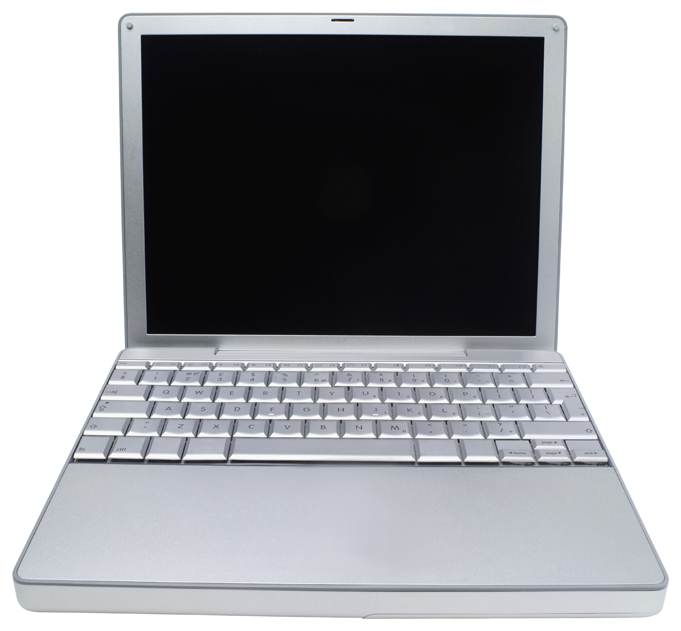
Collecting PCAP
Wireshark
tcpdump
Internet
Tap
Packets
Inline Device
Notes:
Do you collect the same information capturing at different locations on the network? Why or why not?
- Generally no. The contents of a TCP stream might not change but physical (layer 2) traffic will change at each Ethernet hop. NAT can also give a radically different perspective upstream vs. behind the NAT. There is substantial information loss.

Slide 12
Fair Warning
Any plaintext protocol will be visible
Careful what you log in to
You’ll be surprised what uses plaintext

Slide 13
Exercise
Use Wireshark and tcpdump to capture traffic while you ping google.com. What is in the ICMP Echo Request payload?
Both tools installed in your VM
“ping google.com”
You will need to read the tcpdump man page
“man tcpdump”
Notes:
Do it with tcpdump as a class but don’t show -X, then let them go
Talk about snaplen
Talk about –n and when you might want to use it
13:01:55.993329 IP 173.194.43.9 > 172.16.191.136: ICMP echo reply, id 27608, seq 357, length 64
0x0000: 000c 295c 00be 0050 56f4 b5eb 0800 4500 ..)\...PV.....E.
0x0010: 0054 f70a 0000 8001 ff39 adc2 2b09 ac10 .T.......9..+...
0x0020: bf88 0000 ac83 6bd8 0165 435b fc50 0000 ......k..eC[.P..
0x0030: 0000 d9bf 0e00 0000 0000 1011 1213 1415 ................
0x0040: 1617 1819 1a1b 1c1d 1e1f 2021 2223 2425 ...........!"#$%
0x0050: 2627 2829 2a2b 2c2d 2e2f 3031 3233 3435 &'()*+,-./012345
0x0060: 3637 67

Slide 14
Aggregating Taps
Traffic Ports
Monitoring Ports
Notes:
“Bump in the wire”
Collection device can’t change packets
Cheap compared to inline devices
Where might taps be useful? Why? What are their downsides?

Slide 15
Inline Devices
Notes:
Much more expensive than a tap
Typically programmable and able to change specific packets in specific ways
If it fails it takes the link with it
Bad software can also take the link down
Where would an inline device be useful?
Why would you use it in place of a tap? What are the risks?

Slide 16
Naïve PCAP Storage
Double that for full-duplex
Storage can get expensive quickly

Slide 17
Packets Per Second
Notes:
1gbps composed of average packet size 64 bytes
1gbps / (64 * 8 bits) = 10^9 bits/s / 512 bits = 1,953,125 packets per second
1gbps / (1500 * 8 bits) = 10^9 / 12000 = 83,333 pps
1gbps / (9000 * 8 bits) = 10^9 / 72000 = 13888.9 pps

Slide 18
libpcap Format
4 bytes
4 bytes
File Header | Packet Header | Packet Data | Packet Header | Packet Data
24 bytes
x bytes
y bytes

Slide 19
Exercise
How much overhead does libpcap incur storing packets for one hour on a saturated simplex 1gbps link with an average packet size of 1500 bytes?

Slide 20
libpcap overhead
Avg. Packet Size (bytes) | Packets Per Second | Overhead (MB/s) | Overhead (GB / day)
64 | 1,953,125 | 7.45 | 628.64
1500 | 83,333 | 0.32 | 26.82
7981 | 15,662 | 0.06 | 5.04
9000 | 13,888 | 0.05 | 4.47
Notes:
1gbps / (64 * 8 bits) = 10^9 bits/s / 512 bits = 1,953,125 packets per second
1gbps / (1500 * 8 bits) = 10^9 / 12000 = 83,333 pps
1gbps / (9000 * 8 bits) = 10^9 / 72000 = 13888.9 pps

Slide 21
Retention Policies
What to keep and for how long?
Data | Example Retention Period
Full PCAP | Weeks - Months
Flow Records | Indefinitely
DNS | Indefinitely
First N Bytes | Months - Years
Notes:
Since keeping full PCAP indefinitely is unrealistic, what can you retain indefinitely? How do you get maximum value from very little information?
- examples: DNS, DHCP, first N bytes of each packet, flow data, eliminate data you can never decrypt

Slide 22
BerKelEy Packet Filter
Surprisingly Powerful

Slide 23
Berkeley Packet Filter
a.k.a. BPF
“man pcap-filter” on Unix systems
Conceptually similar to Wireshark filters
Filter on layer 2+
Richest in layers 2 – 4
Very fast

Slide 24
Filtering Techniques
BPF is limited, but fast
Compiles to an optimized form
Almost certainly faster than filters you write
If you can use BPF, do it

Slide 25
Demo: Counting TCP Packets
You know a particular backdoor sends exactly one message per TCP packet.
How can you use tcpdump and command line tools to get a rough count of how many messages have been sent?
Notes:
tcpdump –r counting-tcp.pcap -s 0 “host 172.16.0.2 and tcp” 2>/dev/null | wc -l

Slide 26
BPF Logic
Combine BPF primitives with logical operators
NOT, AND, OR
Easy to filter host and TCP/UDP port
Advanced filters for TCP, UDP, ICMP, etc.
Access to raw packet bytes

Slide 27
What Does This Do?
host 8.8.4.4 and udp port 53
Only traffic to
or from this IP
Only traffic to or from this UDP port
Notes:
Shows DNS requests and responses to or from 4.4.2.2. Unless you’re Google, this will show you DNS traffic to and from your computers being answered by Google public DNS.

Slide 28
How About This?
dst host 74.125.228.36 and icmp[icmptype] = icmp-echo

Slide 29
How About This?
ip dst 74.125.228.36 and
icmp[icmptype] = icmp-echo
Only traffic to this IP
Filter on ICMP type
Notes:
ICMP Echo Request (ping) packets with IP destination 74.125.228.36 (resolves to google.com as of 29 December 2012). Will you see Echo Reply packets with this filter?

Slide 30
One More
ip[2:2] >= 86 and ip[8:1] <= 4 and tcp[13:1] & 4 == 4

Slide 31
One More
ip[2:2] >= 86 and ip[8:1] <= 4
and tcp[13:1] & 4 == 4
IP Length >= 86
IP TTL <= 4
TCP RST
Notes:
Why does logical & with 4 work for TCP RST?
This could be written much more easily: “greater 100 and ip[8:1] <= 4 and tcp[tcpflags] & tcp-reset == 1”

Slide 32
Exercise
You need to be notified immediately if anyone sets up a successful TCP handshake to 172.16.191.1 on TCP port 80 or if they send it more than 200 bytes on UDP port 53. Look at alert.pcap.
Write a script using tcpdump that will send you an email when either condition triggers.
Notes:
tcpdump -n -r alert.pcap -XX 'host 172.16.191.1 and ((tcp port 80 and tcp[tcpflags] & 0x12 = 0x12) or (udp port 53 and greater 200))'

Slide 33
Address Resolution Protocol
Is It Plugged In?

Slide 34
Network Connectivity
Internet
HTTP
TCP
IP
ARP
Ethernet
Router
Switch
Notes:
Where could problems occur in here at each layer of the OSI model?
- layer 1: signaling problems
- layer 2: ARP poisoning
- layer 3: DHCP problems
- layer 4: dropped packets, congestion
- layer 5: not too much ;)

Slide 35
ARP
Router
Switch
172.16.0.254
My MAC address is 00:11:22:33:44:55
What is the MAC address for IP 172.16.0.254?
172.16.0.1
Notes:
Where could problems occur in here at each layer of the OSI model?
- layer 1: signaling problems
- layer 2: ARP poisoning
- layer 3: DHCP problems
- layer 4: dropped packets, congestion
- layer 5: not too much ;)

Slide 36
Exercise
Router
Switch
172.16.0.254
Inline Capture
…
172.16.0.1
172.16.0.1
172.16.0.2
172.16.0.253
Notes:
Where could problems occur in here at each layer of the OSI model?
- layer 1: signaling problems
- layer 2: ARP poisoning
- layer 3: DHCP problems
- layer 4: dropped packets, congestion
- layer 5: not too much ;)

Slide 37
Exercise
Open arp[0-9]{3}.pcap
arpN.pcap shows traffic from 172.16.0.N
Identify:
Default router IP address
Default router MAC address
IP and MAC address mappings

Slide 38
ARP Poisoning
Router
Switch
172.16.0.254
172.16.0.1
The MAC address for 172.16.191.2 is 55:44:33:22:11:00
Notes:
Where could problems occur in here at each layer of the OSI model?
- layer 1: signaling problems
- layer 2: ARP poisoning
- layer 3: DHCP problems
- layer 4: dropped packets, congestion
- layer 5: not too much ;)

Slide 39
ARP Poisoning
Intercept all local traffic
Low processor requirements
Existing tools:
arpspoof + fragroute
sslstrip
Ettercap
Cain & Abel

Slide 40
HTTP

Slide 41
Hypertext Transfer Protocol
Line-based protocol
Intuitive fundamentals
Many corner-cases
Ubiquitous
Many uses

Slide 42
Line-Based
Headers are separated by line breaks
“\r\n”
Carriage-Return, Line-Feed
Easy to read
Works with existing line-based tools
grep, sed, awk, tr, etc.
Notes:
Arp133.pcap
Arp136.pcap
Arp138.pcap

Slide 43
HTTP
Header 1
Header 2
Header 3
Header n
Body

Slide 44
Headers
HTTP Verb
Protocol Version
GET / HTTP/1.0
Request Path

Slide 45
Headers
Header Value
Host: www.google.com
Header Name

Slide 46
Example
GET / HTTP/1.0
Host: www.google.com
User-Agent: wget
Connection: close
BodyDataBodyDataBodyDataBodyDataBodyData

Slide 47
Example
19db 5a85 e52c af9c 4745 5420 6874 7470 ..Z..,..GET.http
3a2f 2f78 6b63 642e 636f 6d2f 2048 5454 ://xkcd.com/.HTT
502f 312e 310d 0a55 7365 722d 4167 656e P/1.1..User-Agen
743a 2057 6765 742f 312e 3134 2028 6461 t:.Wget/1.14.(da
7277 696e 3131 2e34 2e32 290d 0a41 6363 rwin11.4.2)..Acc
6570 743a 202a 2f2a 0d0a 486f 7374 3a20 ept:.*/*..Host:.
786b 6364 2e63 6f6d 0d0a 436f 6e6e 6563 xkcd.com..Connec
7469 6f6e 3a20 436c 6f73 650d 0a50 726f tion:.Close..Pro
7879 2d43 6f6e 6e65 6374 696f 6e3a 204b xy-Connection:.K
6565 702d 416c 6976 650d 0a0d 0a eep-Alive....

Slide 48
Example
19db 5a85 e52c af9c 4745 5420 6874 7470 ..Z..,..GET.http
3a2f 2f78 6b63 642e 636f 6d2f 2048 5454 ://xkcd.com/.HTT
502f 312e 310d 0a55 7365 722d 4167 656e P/1.1..User-Agen
743a 2057 6765 742f 312e 3134 2028 6461 t:.Wget/1.14.(da
7277 696e 3131 2e34 2e32 290d 0a41 6363 rwin11.4.2)..Acc
6570 743a 202a 2f2a 0d0a 486f 7374 3a20 ept:.*/*..Host:.
786b 6364 2e63 6f6d 0d0a 436f 6e6e 6563 xkcd.com..Connec
7469 6f6e 3a20 436c 6f73 650d 0a50 726f tion:.Close..Pro
7879 2d43 6f6e 6e65 6374 696f 6e3a 204b xy-Connection:.K
6565 702d 416c 6976 650d 0a0d 0a eep-Alive....
What’s happening here?

Slide 49
Example
GET / HTTP/1.0\r\n
Host: www.google.com\r\n
User-Agent: wget\r\n
Connection: close\r\n
\r\n
Body Data
CRLF splits headers
Blank line with CRLF ends headers

Slide 50
Everybody Try This
$ echo -e "GET / HTTP/1.0\r\n
> Host: www.google.com\r\n
> \r\n" |
> nc www.google.com 80
What Did That Do?

Slide 51
This Is Just Text
How would you find a particular header?
It’s value?
Can you search for strings in the body?
What is the response code?

Slide 52
Exercise: Find All The Titles
We need to extract all of the web page titles from a PCAP. Look in http.pcap for data. List every title exactly once.
Use tcpdump for this exercise.
Notes:
html.pcap
tcpdump -r html.pcap -nn -w - |strings|grep -E '<title>.*</title>’|sed -r 's/<[/]*title>//g'|sort -u

Slide 53
Exercise: All Websites
Find all of the websites that the host 172.16.191.140 visited in websites.pcap. Do not list websites that other hosts visited. Don’t forget about servers that may host multiple websites!
Notes:
Looking for unique hosts, not URI paths
tcpdump -r websites .pcap -n tcp port 80 -w - |strings|grep 'Host: '|sort -u

Slide 54
Limitations
tcpdump and grep fall apart on large PCAPs
tcpdump output not really parseable
Could use libpcap or pynids
Lots of boilerplate code to get going
Not ideal for rapid prototyping

Slide 55
Chopshop
Not Just For Cars

Slide 56
Chopshop
http://www.github.com/MITRECND/chopshop
MITRE-developed packet framework
Based on libnids
TCP reassembly
Handles boilerplate code
Python
Great for rapid prototyping

Slide 57
Chopshop
Framework provides a standard API
Framework does not analyze packets
Modules provide all the brains
Invoke with a list of PCAP files and modules

Slide 58
payloads
Module to dump packet contents
Useful for human-readable protocols
HTTP, SMTP, IMAP, etc.
Few command line flags
Can XOR data
Can hexdump data
Good first step in analysis

Slide 59
Invoking Chopshop
$ chopshop -f http.pcap “payloads ”
Run payloads module on http.pcap
$ find pcaps -type f |
> chopshop “payloads ”
Run payloads on all files in pcaps directory

Slide 60
Simple Obfuscation
Many simple techniques are frustrating
Compression
Packing
Encoding
Obfuscation is not encryption
No key required to “break” it
Still aggravating

Slide 61
XOR
Exclusive Or
Basis for many ciphers
RC4, AES
Fast in hardware
Trivial in most programming languages
Typically a built-in operator
Key management is easy

Slide 62
XOR Truth Table
Operand a | Operand b | Result
1 | 0 | 1
1 | 1 | 0
0 | 0 | 0
0 | 1 | 1

Slide 63
In Other Words
One or the other,
but not both.
Notes:
Due to: http://en.wikipedia.org/wiki/Exclusive_or

Slide 64
Examples
Operand a | Operand b | Result
0111 | 1101 | 1010
1100 | 1100 | 0000
1100 | 1111 | 0011
1111 0000 | 1100 1100 | 0011 1100
1011 0100 | 1010 1010 | 0001 1110
0x10 | 0x0A | 0x1A
0x10 | 0x32 | 0x22

Slide 65
XORcise
$ chopshop -f xor.pcap “payloads ”
Add “-o 0xNN” to XOR contents
Can you guess the XOR key?
Notes:
Need to download PCAP – not included in VM

Slide 66
File Carving From HTTP
Demo: Wireshark
Exercise: chopshop “http_extractor”

Slide 67
Known Unknowns
Why Can’t Everyone Use HTTP?

Slide 68
Unknown Protocols
You will encounter something unfamiliar
Frequently without client or server to test
Malware often uses custom protocols
So do many proprietary programs

Slide 69
Can You Identify It?
Well-known port?
Unusual port/protocol pairing?
This will break Wireshark
Constant or repeating values?
Repeating structure or pattern?
Check beginning of packets
TLV is very common
http://en.wikipedia.org/wiki/Type-length-value

Slide 70
You Can’t?
Can you acquire a client or server?
May need to reverse it
Ask around
Consider obfuscation and encryption
You may need to consider alternatives
Some things will always be a mystery

Slide 71
Endianness
Hexadecimal | Little Endian | Big Endian
10 | 1000 | 0010
432 | 3204 | 0432
5555 | 5555 | 5555
5432 | 3254 | 5432
“network order” is big endian
x86 is little endian

Slide 72
Warmup Exercise
Use tcpdump, chopshop, or Wireshark to identify the “unknown” flows in:
unknown-1.pcap
unknown-2.pcap
unknown-3.pcap
Can you identify the traffic?
Can you decode it? How?
Notes:
Unknown-1.pcap is actually naked SSL (SSL outside the context of e.g., HTTP) on port 22. Wireshark will assume that it’s SSH. You can tell that it’s SSL by looking at the first six bytes sent from client to server or by observing the SSL certificate.
Unknown-2.pcap is a very simple message transmitted in plaintext with a little endian DWORD header that encodes the length of the message that follows.
Unknown-3.pcap is actually the JackCR dfir challenge

Slide 73
DNS
Domain Name System

Slide 74
Domain Name System
Resolve names to IP addresses
e.g. www.google.com -> 74.125.228.3
Most applications use DNS
DNS servers configured in operating system
DHCP
/etc/resolv.conf
Windows NIC Configuration

Slide 75
Message Format
Header
Question
Answer
Authority
Additional
Notes:
See RFC 1035

Slide 76
Header
0 | 1 | 2 | 3 | 4 | 5 | 6 | 7 | 8 | 9 | 10 | 11 | 12 | 13 | 14 | 15
ID
QR | Opcode |  |  |  | AA | TC | RD | RA | Z |  |  | RCODE
QDCOUNT
ANCOUNT
NSCOUNT
ARCOUNT
16 bits (2 bytes) wide
Notes:
See RFC 1035
Header format shared for requests and responses
ID is a random 16 bit int
QR is set to 0 for queries and 1 for responses

Slide 77
Reading Hexdumps
$tcpdump -i eth0 –XX -nn udp port 53
0x0000: 406c 8f4d 5c05 5057 a808 e000 0800 4500
0x0010: 0046 3783 0000 3c11 f4f4 8153 1472 8153
0x0020: 3b17 0035 dda1 0032 60e9 b150 8180 0001
0x0030: 0001 0000 0000 0478 6b63 6403 636f 6d00
0x0040: 0001 0001 c00c 0001 0001 0000 020b 0004
0x0050: 6b06 6a52
Notes:
This is a DNS response for xkcd.com

Slide 78
Exercise: DNS and tcpdump
Can you use a combination of tcpdump and grep to discover what IP address a name resolves to?
google.com
Look at dns-tcpdump.pcap
Notes:
Dns-tcpdump.pcap

Slide 79
Solution
$tcpdump -r dns-tcpdump.pcap “udp port 53” | grep -A 1 google.com
Notes:
Can check that you have the correct response by checking the DNS ID printed by tcpdump

Slide 80
dns_extractor
Bundled chopshop module
Examines UDP packets for DNS
Prints or stores requests and responses

Slide 81
dns_extractor
$chopshop -f dns.pcap “dns_extractor -p”
Print every DNS record
$chopshop -f dns.pcap -J out “dns_extractor -J”
Write DNS records to file “out” in structured format
$find pcaps -type f |
> chopshop “dns_extractor –p”
Run chopshop on every file in the “pcaps” directory
$find /example{01..03} -type f -iname > \*.pcap | sort | chopshop “dns_extractor –p”
Examine PCAPs in three directories in sorted order
Notes:
There was an error on the slides; “-r” should be “-f”

Slide 82
Exercise
List all DNS names and their resolutions found in dns.pcap. Only list each (name, resolution) pair once. You may use chopshop or tcpdump. If you can, do it with both.
Example “file-reader.py” might help
Consider chopshop’s JSON-to-file option

Slide 83
Is Everything As It Seems?
How many (name, resolution) pairs are there?
How many DNS responses?
How many udp src port 53?

Slide 84
Chopshop modules

Slide 85
Module API Basics
taste()
False
True
ignored
handleStream()

Slide 86
Demo
Open my_first_module.py

Slide 87
Mystery Port 53 Traffic
How to understand this traffic?
Is it encrypted or obfuscated?
With what algorithm?
Is there a key? Can you acquire it?

Slide 88
XOR in Python
s = “\x00\x01\x01\x01\x04\x05”
key = 0x01
out = “”
for char in s:
out += chr(ord(char) ^ key)
XOR Operator
Convert character to int

Slide 89
XORcise
Decrypt and characterize the mystery traffic
Tips:
Remember the principles we just discussed
Iterate quickly
Worry about the process, not results

Slide 90
Outcomes
You captured PCAP
You worked on solving realistic, challenging PCAP analysis problems
You studied how and when to use different tools and how they might lie to you
You analyzed an unknown protocol

Slide 91
Hopefully…
You understand how PCAP can help you accomplish your goals
You can use a fundamental understanding of network protocols to go above and beyond existing tools
You had fun!

