Slide 1
Introduction to Intel x86-64 Assembly, Architecture, Applications, & Alliteration
Xeno Kovah – 2014
xkovah at gmail

Slide 2
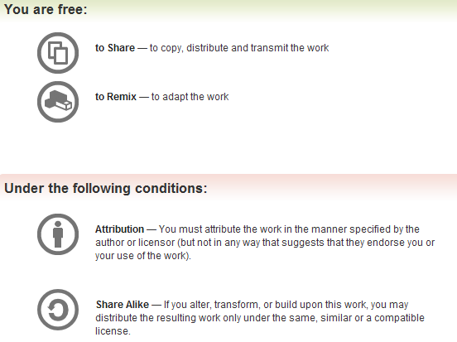
All materials is licensed under a Creative Commons “Share Alike” license.
http://creativecommons.org/licenses/by-sa/3.0/
Attribution condition: You must indicate that derivative work
"Is derived from Xeno Kovah's 'Intro x86-64’ class, available at http://OpenSecurityTraining.info/IntroX86-64.html”
Notes:
Attribution condition: You must indicate that derivative work
"Is derived from Xeno Kovah's ‘Intro x86-64’ class, available at http://OpenSecurityTraining.info/IntroX86-64.html"

Slide 3
Intel vs. AT&T Syntax
Intel: Destination <- Source(s)
Windows. Think algebra or C: y = 2x + 1;
mov rbp, rsp
add rsp, 0x14 ; (rsp = rsp + 0x14)
AT&T: Source(s) -> Destination
*nix/GNU. Think elementary school: 1 + 2 = 3
mov %rsp, %rbp
add $0x14,%rsp
So registers get a % prefix and immediates get a $
My classes will use Intel syntax except in this section
But it’s important to know both, so you can read documents in either format.

Slide 4
Intel vs AT&T Syntax 2
For instructions which can operate on different sizes, the mnemonic will have an indicator of the size.
movb - operates on bytes
mov/movw - operates on word (2 bytes)
movl - operates on “long” (dword) (4 bytes)
movq - operates on “quad word” (qword) (8 bytes)
Intel indicates size with things like “mov dword ptr [rax], but it’s not in the actual mnemonic of the instruction
Will occasionally see things like “movzwl” which is move with zero extend from a word to a long

Slide 5
Intel vs AT&T Syntax 3
In my opinion the hardest-to-read difference is for r/m32 values
For intel it’s expressed as
[base + index*scale + disp]
For AT&T it’s expressed as
disp(base, index, scale)
Examples:
call DWORD PTR [rbx+rsi*4-0xe8]
callq *-0xe8(%rbx,%rsi,4)
mov rax, DWORD PTR [rbp+0x8]
movq 0x8(%rbp), %rax
lea rax, [rbx-0xe8]
leaq -0xe8(%rbx), %rax
Notes:
And some versions of the gnu tools, instead of using like “mov -0x4(%rbp)” will show it as “mov 0xFFFFFFFC(%rbp)”
Some more links talking about the differences
http://www.w00w00.org/files/articles/att-vs-intel.txt <- haxors ;)
http://en.wikipedia.org/wiki/X86_assembly_language
http://sig9.com/articles/att-syntax

Slide 6
TODO
Create a game that shows two instructions in AT&T syntax and Intel syntax, and asks the students whether they’re the same or not
(The +100/-200 helps mitigate advantage of guessing)

