Slide 1

Android
Forensics
and Security Testing
Shawn Valle
shawnvalle at gmail dot com
September 2012

Slide 2


Introductions
Android
Forensics
15 years in IT and security (CISSP, MCP, LCP)
Course developer / trainer at IBM’s Catapult Software Training & independently
JavaScript, HTML, web app development, content management, identity management, Lotus Domino
Began working with mobile computing in 2006 (PalmOS app/ROM development)
Joined MITRE in 2008 working in network and app security
Co-established MITRE’s Mobile Security Practice in 2010, leading engineering and coordination in several mobile computing projects

Slide 3
Learning Objectives
Android
Forensics
By the end of this course, you will be able to:
Extract and analyze data from an Android device
Manipulate Android file systems and directory structures
Understand techniques to bypass passcodes ^{NEW!}
Utilize logical and physical data extraction techniques
Reverse engineer Android applications
Analyze acquired data

Slide 4


Books
Android
Forensics
Hoog, Andrew (2011). Android Forensics, Syngress.
Dwivedi, Himanshu, Clark, Theil (2010). Mobile Application Security, McGraw-Hill.

Slide 5
Agenda
Android
Forensics
DAY 1
Forensic Introduction
Course Setup – Linux, OS X, and Windows
Android Overview
SDK and AVD
Android Security Model
ADB and shell Introduction
BREAK
File System and Data Structures
LUNCH
Device Handling
Circumvent passcode
Gain Root Access
Recovery Mode
Boot Loaders
BREAK
Logical Forensic Techniques
Open Source Tools
Commercial Tools

Slide 6
Agenda
Android
Forensics
DAY 2
Physical Forensic Techniques & Tools
BREAK
Forensic Analysis
LUNCH
Application Penetration Testing Setup
Reverse Apps
BREAK
…more Reversing
Document Findings

Slide 7
Prerequisites
Android
Forensics
Introduction to Android Development
and / or
Introduction to Linux

Slide 8
Legalities
Android
Forensics
Possibility of Android devices being involved in crimes
Easily cross geographical boundaries; multi-jurisdictional issues
Forensic investigator should be well aware of regional laws
Data may be altered during collection, causing legal challenges
Fully document justification for data modification
Notes:
Since these devices are extremely compact
there is every possibility of them being involved in crimes,
which can easily cross geographical boundaries.
In order to tackle these multi-jurisdictional issues,
the forensic investigator should be well aware of the nature of the crime and the regional laws.

Slide 9

Forensic Investigations

Slide 10
Terms and Definitions
Android
Forensics
Mobile Forensics is defined as “the science of recovering digital evidence from a mobile phone under forensically sound conditions using accepted methods.” (NIST)
A penetration test, occasionally pentest, is a method of evaluating the security of a computer system or network by simulating an attack from malicious outsiders (who do not have an authorized means of accessing the organization's systems) and malicious insiders (who have some level of authorized access). (Wikipedia)
A vulnerability assessment is the process of identifying, quantifying, and prioritizing (or ranking) the vulnerabilities in a system.
Notes:
http://www.basistech.com - Our Washington, DC-based team is routinely engaged to train government operatives in the recovery and analysis of data from captured devices for cellphone exploitation (CELLEX).
CELLEX - Not as concerned about all the data, chain of custody, etc. Intelligence gathering.

Slide 11
What is Mobile Forensics
& Why Should I Care?
Android
Forensics
The acquisition and analysis of data from devices,
Internal corporate investigations, civil litigation, criminal investigations, intelligence gathering, and matters involving national security.
Arguably the fastest growing and evolving digital forensic discipline, offers significant opportunities as well as many challenges.

Slide 12
Forensic Overview
Android
Forensics
General to forensics, not just Android.
Potential scenarios:
  Evidence gathering for legal proceedings
  Corporate investigations
    Intellectual property or data theft
    Inappropriate use of company resources
    Attempted or successful attack against computer systems
    Employment-related investigations including discrimination, sexual harassment
    Security audit
  Family matters
    Divorce
    Child custody
    Estate disputes
  Government security and operation
    Cyber Threats, Advanced Persistent Threat
    Stopping cyber attacks
    Investigating successful attacks
    Intelligence / Counter-intelligence gathering

Slide 13
Forensic Considerations
Android
Forensics
Important items to consider during investigation:
  Chain of custody
  Detailed notes and complete report
Validation of investigation results, using tools or other investigators

Slide 14

Android Overview & History
…in five minutes

Slide 15
Android Overview & History
Android
Forensics
Google Mobile SVP Andy Rubin reported that over 850,000 Android devices were being activated each day as of February 2012
500,000 increase per day over just one year ago
Notes:
Google: 850,000 Android Devices Activated Every Day
Retrieved March 11, 2012
http://mashable.com/2012/02/27/android-daily-activations/
Google Investor: Google android activating 350,000 devices daily (data visualization video) “Top global smartphone platform.” (n.d.). Retrieved March 9, 2011, from http://googinvestor.blogspot.com/2011/03/google-android-activations-350k-daily.html.

Slide 16
Android Overview & History
Android
Forensics
Operating System | 3Q11 Market Share (%) | 3Q10 Market Share (%)
Android | 52.5 | 25.3
Symbian | 16.9 | 26.3
iOS | 15 | 16.6
RIM | 11 | 15.4
Worldwide Smartphone Sales to End Users
Notes:
Source: Gartner (November 2011)

Slide 17
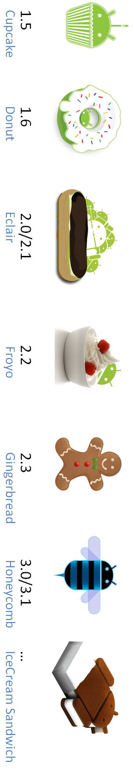
Android Overview & History
Date | Event
July 1, 2005 | Google acquires Android, Inc.
November 12, 2007 | Android launched
September 23, 2008 | Android 1.0 platform released
February 13, 2009 | Android Market: USA takes paid apps
April 15, 2009 | Android 1.5 (Cupcake) platform released
September 16, 2009 | Android 1.6 (Donut) platform released
October 5, 2009 | Android 2.0/2.1 (Eclair) platform released
May 20, 2010 | Android 2.2 (Froyo) platform released
December 6, 2010 | Android 2.3 (Gingerbread) platform released
February 2, 2011 | Android 3.0 (Honeycomb) preview released
November 14, 2011 | Android 4.0 (Ice Cream Sandwich), 3.0 source released
July 9, 2012 | Android 4.1 (Jelly Bean) platform released
Notes:
Image source: http://xmscan.files.wordpress.com/2011/06/android-version-name-history1.png

Slide 18
Android Overview & History
Android
Forensics
Android Feature Introduction
  More details come later
  1st Primary feature, always connected: GSM, CDMA, LTE, WiMax, WiFi
  2nd Market / Play: rich source for forensic analysts
  3rd Data Storage: Big part of the course
    Flash (or NAND) memory
    External SD card
    Internal SD card
Notes:
Source: Hoog, Android Forensics

Slide 19
Android Overview & History
Android
Forensics
Cellular Networks and Hardware
  Global System for Mobile Communications – GSM
    Subscriber identity module (SIM) or universal subscriber identity module (USIM) to identify the user to the cellular network
    AT&T, T-Mobile
  Code Division Multiple Access – CDMA
    Sprint, Verizon
  Integrated Digital Enhanced Network – iDEN
    Sprint
  Worldwide Interop for Microwave Access – WiMax
    Sprint
  Long Term Evolution – LTE
    AT&T, Sprint, T-Mobile, Verizon

Slide 20
Android Overview & History
Android
Forensics
Apps
  As of January 2012, over 400,000 Android apps have been developed. Doubled since January 2011.
  Apple maintains tight control over their App Store, requiring developers to submit to a sometimes lengthy review process and providing Apple with the ﬁnal approval for an app. Apps can be denied based on a number of criteria, most notably if they contain any content Apple feels is objectionable.
  Google, on the other hand, requires very little review to publish an app in the Android Market. While Google has the ability to ban a developer, remove an app from the Android Market, and even remotely uninstall apps from Android devices, in general their approach to app management is hands off. (Hoog)

Slide 21
Android Open Source Project
Android
Forensics
The Android Open Source Project (AOSP) is led by Google, and is tasked with the maintenance and development of Android.
It is good experience to download and install AOSP from source.
Not critical for all forensics analysts to get this deep into Android. May be helpful for deep analysis.
We won’t be doing that in this course…

Slide 22

Brief Linux Overview

Slide 23
Linux, Open Source Software
& Forensics
Android
Forensics
  Open source software has had a tremendous impact on the digital forensics discipline. Forensic tools that are released as free open source software have tremendous advantages over closed source solutions including the following:
    The ability to review source code and understand exact steps taken
    The ability to improve the software and share enhancements with entire community
    The price
  Linux is not only a critical component of Android but can also be used as a powerful forensic tool.

Slide 24
Linux Commands
Android
Forensics
man
help
cd
mkdir
mount
rmdir/rm
nano
ls
tree
cat
dd
find
chmod
chown
sudo
apt-get
grep
| and >
… see Linux Commands handout for valuable commands
Notes:
These are some Linux commands that are useful when using Ubuntu as a forensic workstation, but also come in handy when we access an Android shell, which is Linux.
If these commands are foreign to you, suggest a refresher course/book in Linux commands.
Due to time, we will not be covering detailed definitions of Linux commands, though we will highlight and define the commands we use, as we go.

Slide 25

Android and Forensics

Slide 26
Android & Forensics
Android
Forensics
Relatively new, emerged in ~2009
Best known expert in the field is Andrew Hoog
Other leaders in the Android Security field include Jon Oberheide and Zach Lanier
Community is rapidly growing
In-house investigations on pilot / prototype apps
Penetration tests
Vulnerability assessments
Funded research
Notes:
These are some Linux commands that are useful when using Ubuntu as a forensic workstation, but also come in handy when we access an Android shell, which is Linux.
If these commands are foreign to you, suggest a refresher course/book in Linux commands.
Due to time, we will not be covering detailed definitions of Linux commands, though we will highlight and define the commands we use, as we go.

Slide 27
Course Setup

Slide 28
Course Setup
Android
Forensics
Ubuntu Linux distribution with Android SDK
  Ubuntu 11.10 32-bit running on VMWare. Fully functional free, open-source environment for you to keep after the course is over.
  http://www.vmware.com/
  Need 20GB hard drive space and 2+GB RAM for the VM
  http://www.ubuntu.com/download/ubuntu/download
Windows for some commercial tools
Notes:
Also have 64-bit version built for VirtualBox

Slide 29
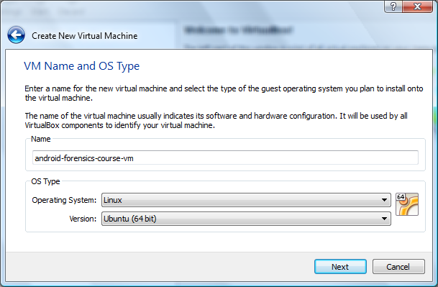
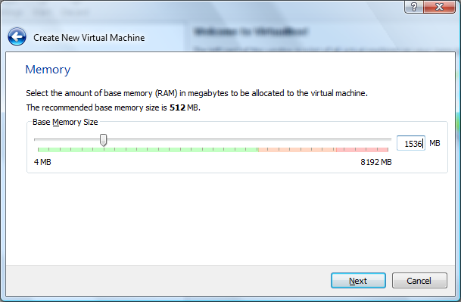
VM Setup – 1 of 7
Android
Forensics

Slide 30
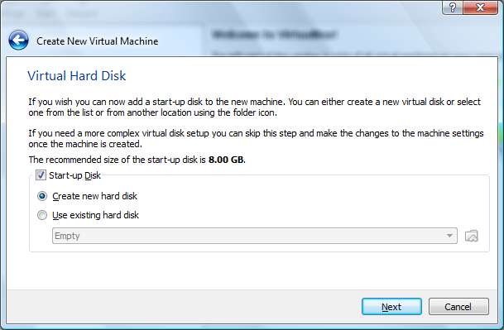
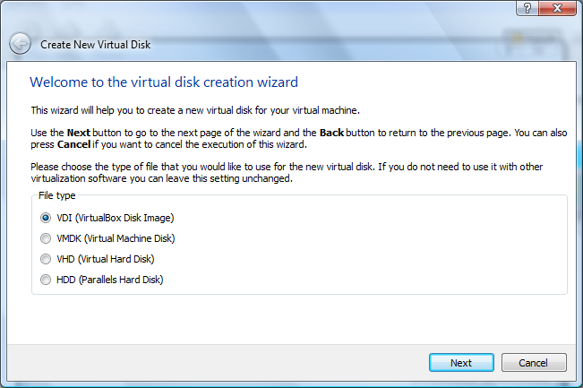
VM Setup – 2 of 7
Android
Forensics

Slide 31
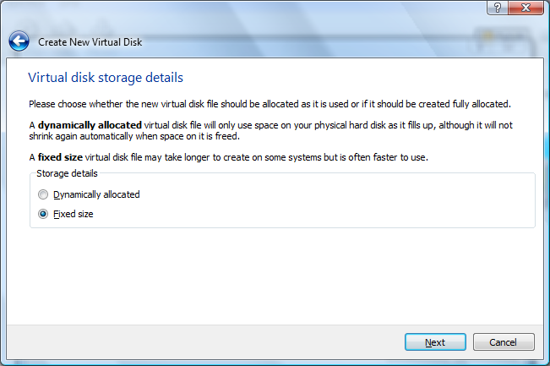
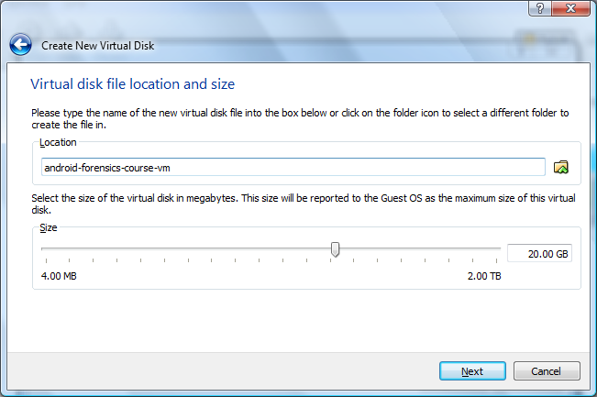
VM Setup – 3 of 7
Android
Forensics

Slide 32
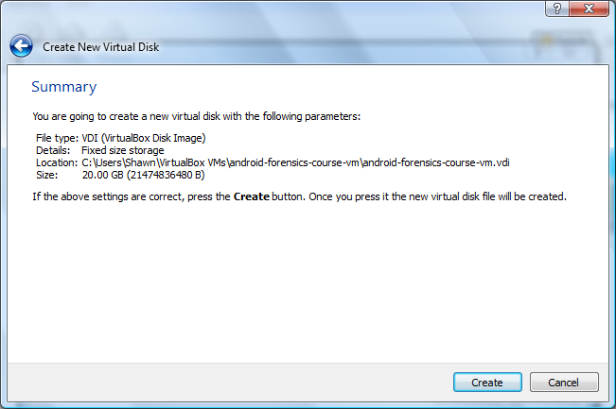
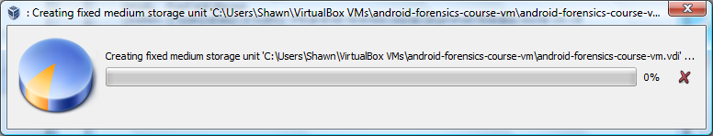
VM Setup – 4 of 7
Android
Forensics

Slide 33
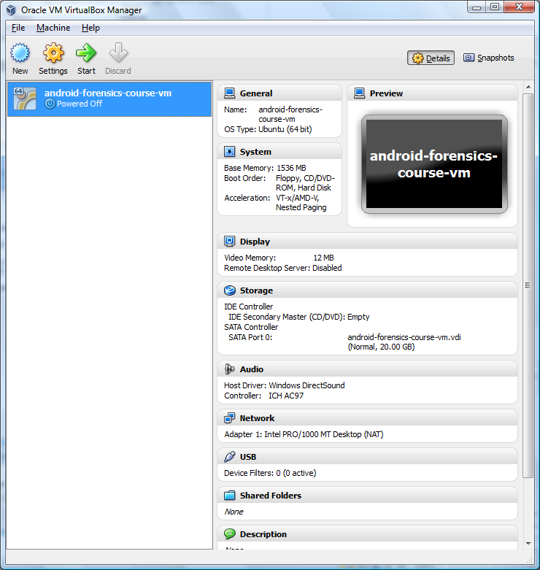
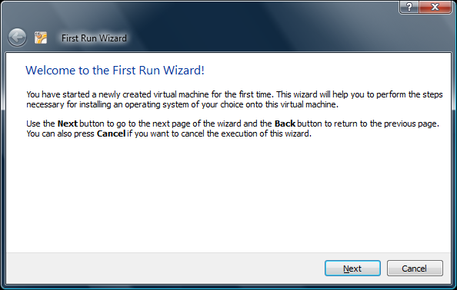
VM Setup – 5 of 7
Android
Forensics

Slide 34
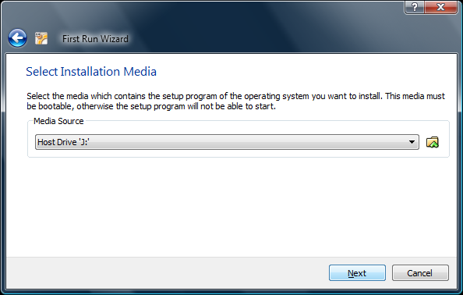
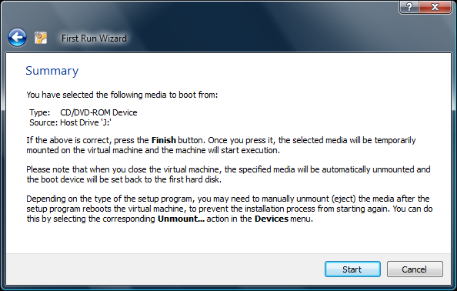
VM Setup – 6 of 7
Android
Forensics

Slide 35
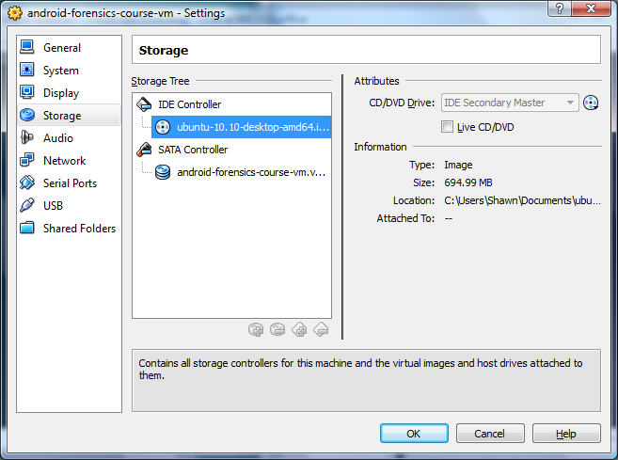
VM Setup – 7 of 9
Android
Forensics
  Ubuntu
    User name: student
    Password: password1

Slide 36
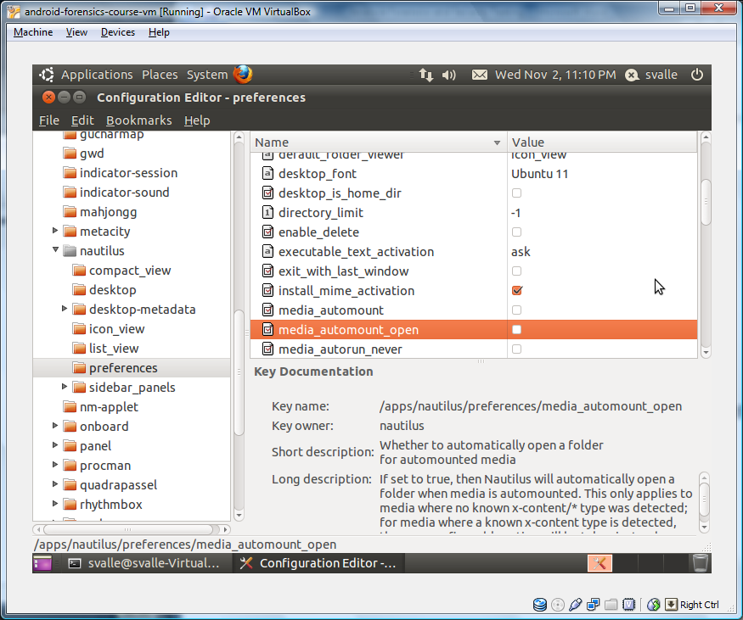
Forensic Workstation Setup
Android
Forensics
  Disable Automount
    Command: gconf-editor
    Navigate to apps > nautilus > preferences, uncheck “media_automount” and “media_automount_open”
Notes:
Slide only needed on some instances of the VM. Initially used on first Virtual Box build, but automatically setup on the VMWare build.

Slide 37

Android
Architecture

Slide 38
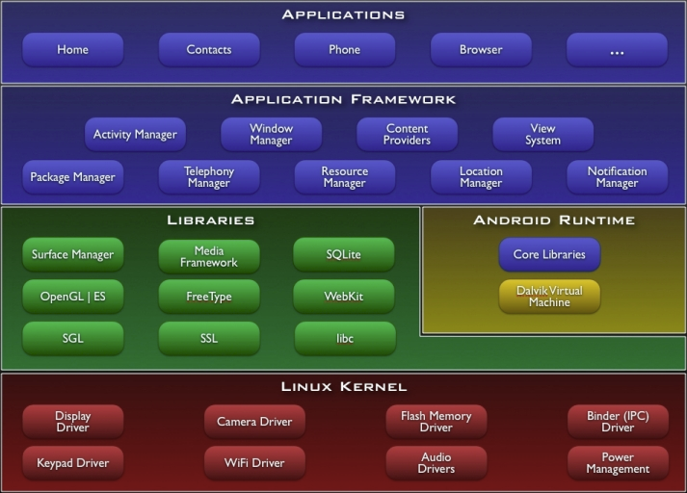
Got Android?
Android
Forensics
Notes:
http://developer.android.com/guide/basics/what-is-android.html
Based on Linux 2.6 kernel.
Flash Memory important for forensics
Libraries (core libraries)
SQLite is important for forensic analysis
Runtime
Contains Dalvik, custom JVM
We will explore the details of Dalvik VM when we RE an app.
Dalvik VM uses file format Dalvik Executable (.dex).
Java Archive (.jar) gets converted to .dex upon compilation, providing optimization .
We will use smali (by JesusFreke) to decompile .dex files.
App Framework
Resources access via SDK by developers
We will focus on much of these areas during our forensic data extraction and application reverse engineering
For more deep info on the Android architecture and application development framework, suggest Android Internal and Intro to Android Dev.
NDK – Add more if we want to address.

Slide 39

Much ado about hardware

Slide 40
Hardware - core
Android
Forensics
CPU
Radio
Memory (RAM & NAND Flash)
GPS
WiFi
Bluetooth
SD Card
Screen
Camera(s)
Keyboard
Battery
USB
Accelerometer / Gyroscope
Speaker
Microphone
SIM
Notes:
CPU – ARM and Intel x86
RAM – Random Access Memory; loads and runs OS, apps, and data; is volatile
NAND – Nonvolatile, persistent; stores bootloader, OS, and data
SD Card – varies per device. External SD uses NAND. Some phones (Nexus) emulate an SD Card by partitioning on-board NAND.
Camera – Front, back; GPS tracked photos; time/date stamp; barcode reader
Battery – to get to SD Card/SIM, often must remove battery, powering off device. Dangerous for forensics.
USB – Used for ADB, much of this class; connecting R/W to memory, modifying stored data.

Slide 41
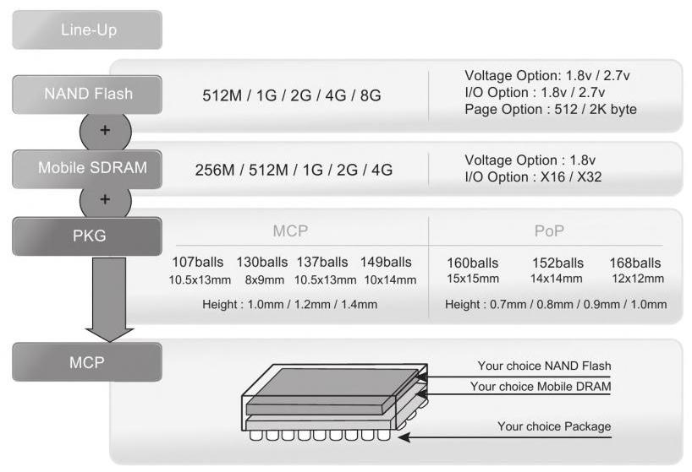
More Memory
Android
Forensics
Memory (RAM & NAND Flash)
Manufactured together into multichip package (MCP)
Notes:
RAM – Random Access Memory; loads and runs OS, apps, and data; is volatile
NAND – Nonvolatile, persistent; stores bootloader, OS, and data

Slide 42
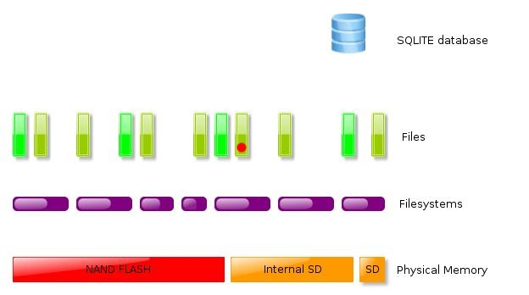
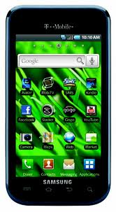
Samsung Vibrant Galaxy S
Android 2.2 (Froyo)
Android
Forensics
Logical
Logical
Physical
/dbdata
/data
Physical
Wear leveling
Notes:
the different layers of memory. nand below partitions below files.
Notice logical and physical. Important to remember, as we get into different types of forensics acquisition.
Logical, possible with default manufacturer device permission
Physical, requires superuser permissions.

Slide 43
Hardware - devices
Android
Forensics
Smartphones
Tablets
Google TV
Vehicle Stereos
Standalone GPS
Kindle Fire
B&N Nook
700+ Android devices

Slide 44
ROM & Boot Loaders
Android
Forensics
ROM varies by manufacturer
Contains boot process
seven key steps to the Android boot process:
  Power on and on-chip boot ROM code execution
  The boot loader
  The Linux kernel
  The init process
  Zygote and Dalvik
  The system server
  Boot complete
Notes:
Boot loader – separate from Linux kernel; the boot loader has two distinct stages: the initial program load (IPL) and the second program loader (SPL).
Init - starts key system and user processes; similar to the /etc/init.d scripts found on traditional Linux devices; init.rc is typically located on the root file system and provides the kernel with the details on how to start core services.

Slide 45
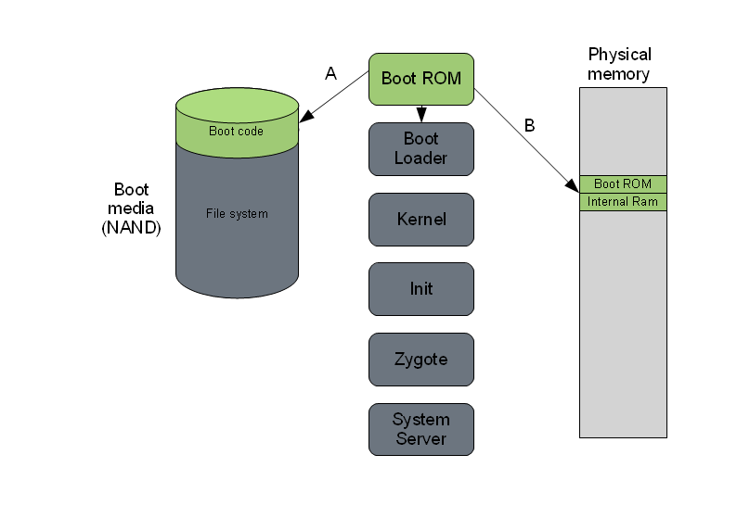
ROM & Boot Loaders
Android
Forensics
Notes:
Boot loader – separate from Linux kernel; the boot loader has two distinct stages: the initial program load (IPL) and the second program loader (SPL).
Init - starts key system and user processes; similar to the /etc/init.d scripts found on traditional Linux devices; init.rc is typically located on the root file system and provides the kernel with the details on how to start core services.

Slide 46

Security
Model

Slide 47
Security Model
Android
Forensics
At app (.apk) installation, Android checks for developers unique signature.
  NOTE: Not signed by a CA.
  Key is the responsibility of the developer.
After signature validation, Android check the permissions (AndriodManifest.xml) needed for the app, designated by the developer.
  For example: network access, GPS access, access to storage
Checking an app’s permissions, compared to its functionality could give a clue if an app has potential malicious intent. Important area to look at for forensics analysis.
Notes:
At app (.apk) installation, Android checks for developers unique signature.
NOTE: Not signed by a CA.
Key is the responsibility of the developer.
After signature validation, Android check the permissions (AndriodManifest.xml) needed for the app, designated by the developer.
For example: network access, GPS access, access to storage
Checking an app’s permissions, compared to its functionality could give a clue if an app has potential malicious intent. Important area to look at for forensics analysis.

Slide 48
Application Security
Android
Forensics
Quick intro/review of Android security model
Every application (.apk) gets a unique Linux user ID and group ID
Apps run with their unique user ID
Each running app gets its own dedicated process and a dedicated Dalvik VM
Each app has its own storage location in /data/data/<app>, only accessible by the unique user ID and group ID
Apps can share data with other apps using Content Providers (see Intro to Android App Dev for details)
.java
java
.class
dx
.dex
Notes:
App installed.
Android creates a Linux user ID and group ID for each installed app.
This creates a security perimeter allowing only apps with the same user ID access to the same Dalvik VM.
Each app get its own directory on device for app and data storage, and is only accessible by its Linux User ID.
This is the basis for data security in Android, and the core of the Android Security Model.
Android Runtime – Dalvik VM (Sutterfield)
Runs every Android app (.apk)
Each Android app runs in its own process
Each Android app has its own instance of the VM
Properties
Written to allow multiple VM instances to run efficiently
Low memory requirements
Register based (no stack)
Linux provides process isolation, memory management and threading support
Runs Dalvik bytecode (.dex files)
Java .class / .jar files are converted to .dex at build time

Slide 49

Android SDK

Slide 50
Android Tools Needed
Android
Forensics
Android SDK (Software Development Kit)
  Though we are not going to use any of the development tools for device forensics
AVD (Android Virtual Device)
ADB (Android Debug Bridge)

Slide 51
SDK Setup
Android
Forensics
Android 4.1 (newest) , 2.3.3, and 2.2 (most used) SDK is already installed on Ubuntu workstation
For more: http://blog.markloiseau.com/2011/06/how-to-install-the-android-sdk-and-eclipse-in-ubuntu/
Eclipse installed, not needed for device forensics, but will be used for later application reverse engineering

Slide 52
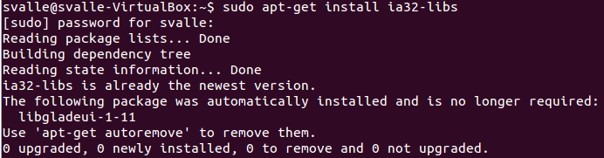
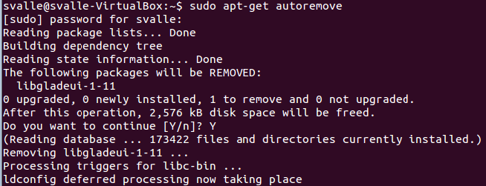
SDK Install via command
Android
Forensics
copy the android sdk to /opt
sudo -s cp -r android-sdk_r20.0.3-linux.tgz /opt
change you into the Android working directory
cd /opt
unpack your Android SDK
sudo -s tar xvzf android-sdk_r20.0.3-linux.tgz
make the /opt directory and the Android SDK writable and executable for all users
sudo -s chmod -R 755 /opt/android-sdk-linux
Notes:
If you are running a 64-bit distribution of Android SDK on your development machine, you need to install the ia32-libs
sudo apt-get install ia32-libs
Download, Install and Configure the Android SDK
sudo -s cp -r android-sdk_r20.0.3-linux.tgz /opt

Slide 53
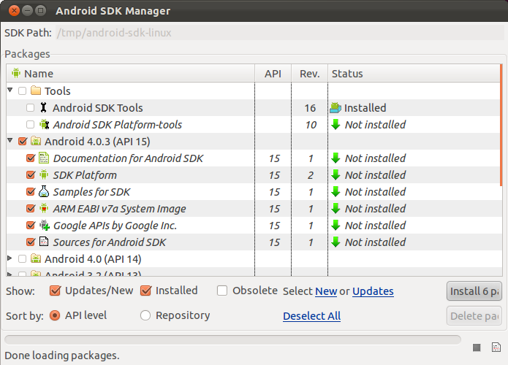
SDK Manager
Android
Forensics
Starting up Android
SDK and Android
Virtual Device (AVD)
manager from
terminal
  Icon on desktop, or
  $ cd /opt/android/tools
  $ ./android
Notes:
Put proxy on the board.
gatekeeper.mitre.org
Port 80
Located in Tools > Options

Slide 54
SDK Plugins
Android
Forensics
Download the SDK plugins you want.
  For us: 4.1 (newest), 2.3.3, and 2.2 (most used)
  Choose whichever SDK is appropriate for the device you are analyzing.

Slide 55
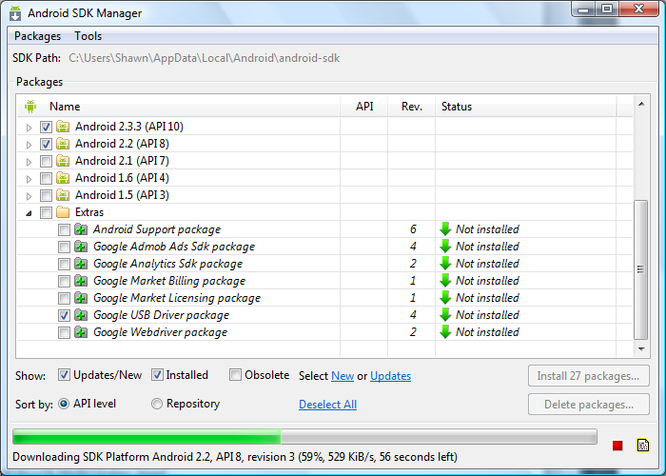
USB Drivers in Windows
Android
Forensics
Adding USB Drivers in Windows is very easy.
Notes:
If you're developing on Windows, you need to install a USB driver for adb. If you're using an Android Developer Phone (ADP), Nexus One, or Nexus S, see the Google Windows USB Driver. Otherwise, you can find a link to the appropriate OEM driver in the OEM USB Drivers document.
Download and install Android SDK.
In Android SDK Manager, expand Extras and check “Google USB Driver package”
Update Environment Variables PATH
Example: C:\Users\Shawn\AppData\Local\Android\android-sdk\platform-tools

Slide 56
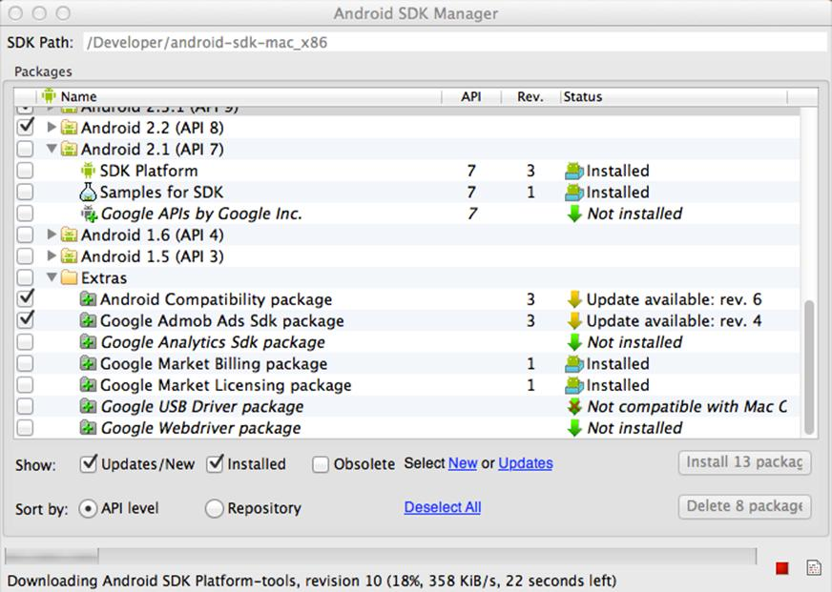
USB Drivers in OS X Lion (1 of 2)
Android
Forensics
If you're developing on Mac OS X, it just works.
Notes:
Run SDK Manager and add some available packages.
Update PATH (similar to Linix)

Slide 57
USB Drivers in OS X Lion (2 of 2)
Android
Forensics
Update PATH for Android tools
  nano –w ~/.bash_profile
  export PATH=${PATH}:<sdk>/tools:<sdk>/platform-tools
  Close / reopen Terminal

Slide 58
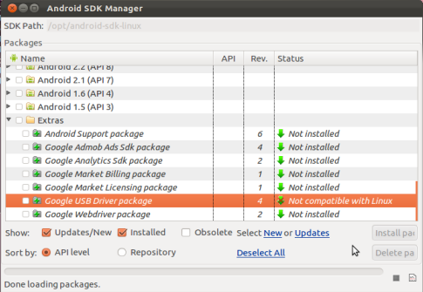
USB Drivers in Linux
Android
Forensics
Add a udev rules file
Contains a USB configuration for each type of device
Notes:
Set up your system to detect your device – Linux
If you're developing on Ubuntu Linux, you need to add a udev rules file that contains a USB configuration for each type of device you want to use for development. In the rules file, each device manufacturer is identified by a unique vendor ID, as specified by the ATTR{idVendor} property. For a list of vendor IDs, see USB Vendor IDs, below. To set up device detection on Ubuntu Linux:
In Android SDK Manager, USB Driver package is not compatible with Linux, requiring the more cumbersome UDEV rules setup.

Slide 59
USB Vendor IDs
Android
Forensics
Company | USB Vendor ID
Acer | 0502
ASUS | 0B05
Dell | 413C
Google | 18D1
HTC | 0BB4
Lenevo | 17EF
LG | 1004
Motorola | 22B8
Nook | 2080
Samsung | 04E8
Toshiba | 0930
This table provides a reference to the vendor IDs needed in order to add USB device support on Linux. The USB Vendor ID is the value given to the ATTR{idVendor} property in the rules file, as described above.
Notes:
terminal: lsusb - when devices connected via USB, run this command to get Vendor ID

Slide 60
UDEV Rules
Android
Forensics
Log in as root and create this file:
  sudo nano -w /etc/udev/rules.d/51-android.rules
  Use this format to add each vendor to the file:
  SUBSYSTEM=="usb", ATTR{idVendor}=="0bb4", MODE="0666", GROUP="plugdev"
      I used:
  #HTC
  SUBSYSTEM==”usb”, SYSFS{idVendor}==”0bb4”, MODE=”0666”

Slide 61
Final UDEV Touches
Android
Forensics
Make file readable to all:
  sudo chmod a+r /etc/udev/rules.d/51-android.rules
UDEV Rules Overview:
  http://reactivated.net/writing_udev_rules.html

Slide 62
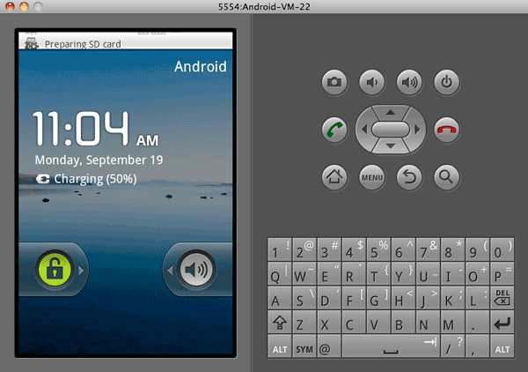
Android Virtual Device (AVD)

Slide 63
AVD (Emulator) and connecting devices
Android
Forensics
Forensics analysts utilize AVD/emulator to learn app execution on a device
Useful for validating investigation findings
Useful for testing a forensics or reverse engineering tool an Android device or app
Terminal: android (will start up AVD)

Slide 64
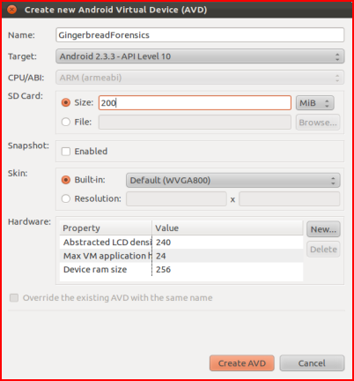
Create AVD
Android
Forensics
Location of AVD Files:
Desktop OS | AVD Data Location
Ubuntu | /home/<username>/.android
Max OS X | /Users/<username>/.android
Windows 7 | C:\Users\<username>\.android

Slide 65
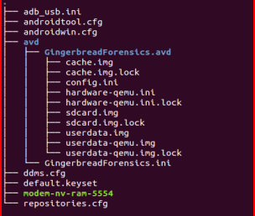
/.android
Directory Tree
Android
Forensics
Command: tree

Slide 66

Interesting Files
Android
Forensics
cache.img: disk image of /cache partition
sdcard.img: disk image of SD card (if created during AVD setup)
userdata-qemu.img: disk image of /data partition
More details on these directories later

Slide 67
REVIEW
Android
Forensics
Learned a brief overview of Android and Linux
Defined the basics of forensics, penetration testing, and vulnerability assessments
Explored the hardware components of an Android device
Familiarized with the Forensics Workstation and Android AVD

Slide 68
EXERCISE
Android
Forensics
Create AVD and explore directories of interest
  Create FroyoForensics AVD or AVD based on your own Android device
  Explore /.android subdirectories
  Locate cache.img

Slide 69
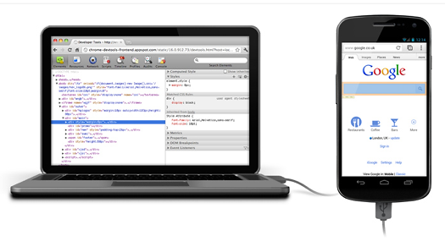
Connecting a Device for Forensics

Slide 70
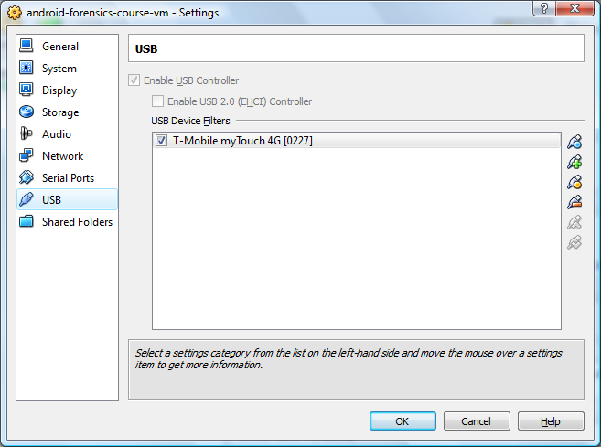
Connecting Device to VM
Android
Forensics
Mac OS X with VMWare Fusion
VirtualBox
Notes:
Mac OS X with VMWare Fusion
Virtual Machine > USB > Connect
Using VirtualBox
Settings > USB

Slide 71
Setting up USB Interfaces
Android
Forensics
Each device has different USB setting options when connected to a PC
Some options are:
  Charge only
  Sync
  Disk drive
  Mobile Broadband Connect

Slide 72

USB Connection Test
Android
Forensics
To ensure the device is connected and passing through the “host” OS to the Ubuntu VM
  Open a terminal window and type dmesg (display message or driver message)
Notes:
SCSI removable disk, sdb. That’s the SD card on my HTC phone.

Slide 73
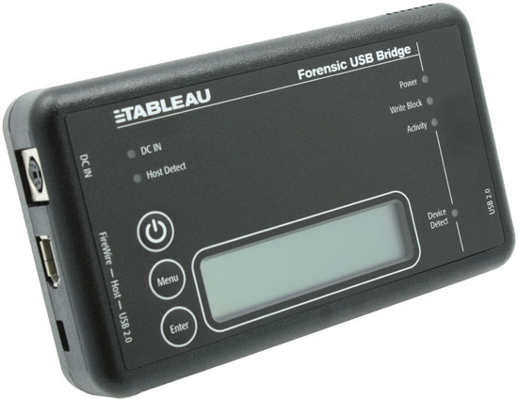
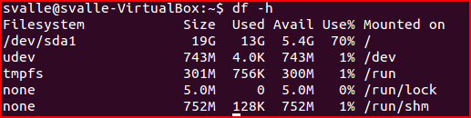
USB Forensics Precaution
Android
Forensics
Important to disable auto-mount to prevent automatic detection and mounting of USB mass storage
Critical to limit and modifications to device when acquiring forensic data (more later)
A hardware USB write blocker is an option
To check for mounted SD cards, use df command.
Notes:
Not proven, though understand that write blocker may still allow ADB. Some test have proven that write blockers still allow modification of the Android device.
Write blockers, ~$200-$300. Tableau
UltraBlock USB Write Blocker
We will learn more about ADB in a few minutes.

Slide 74
SD Card Info

Slide 75
SD Card
Android
Forensics
Most developers store large data files on SD cards.
Core application data is located in /sdcard/data/data

Slide 76
Android Debug Bridge

Slide 77
Android Debug Bridge
Android
Forensics
One of the most important pieces of Android forensics.
Best time to pay attention is now.
Android Debug Bridge (ADB)
  Developers use this, forensic analysts and security analysts rely on this.

Slide 78
USB Debugging
Android
Forensics
Enable USB debugging on device
  Applications > Development > USB Debugging
  This will run adb daemon (adbd) on device.
  adbd runs as a user account, not an admin account. No root access. Unless your device is rooted, then adbd will run as root.
  If the device is locked with a pass code, enabling USB debugging is difficult.

Slide 79
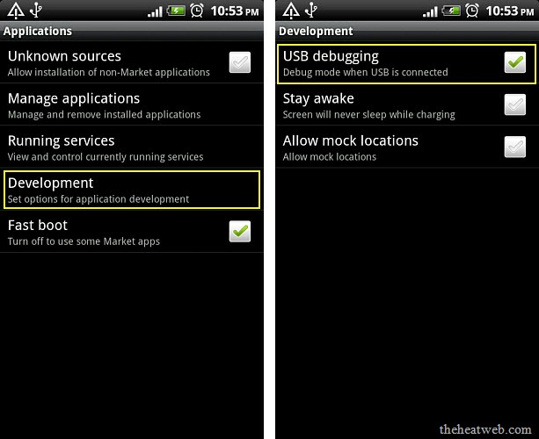
USB Debugging
Android
Forensics
Notes:
Users may have already enabled USB debugging if:
They are involved in app development
Some commercial apps require USB debugging, for example tethering apps
Custom ROMs (CyanogenMod, etc)
Google developer phones

Slide 80
USB Debugging
Android
Forensics
Enable USB debugging on device
  Applications > Development > USB Debugging
  This will run adb daemon (adbd) on device.
  adbd runs as a user account, not an admin account. No root access. Unless your device is rooted, then adbd will run as root.
  If the device is locked with a pass code, enabling USB debugging is difficult.

Slide 81
ADB Components
Android
Forensics
Three components
  adbd on device
  adbd on workstation
  adb on workstation
adb is free, open-source, and our primary tool for Android forensics
Notes:
Prepare for using adb a lot over the next two days.

Slide 82

ADB Devices
Android
Forensics
To identify devices connected, use command adb devices

Slide 83
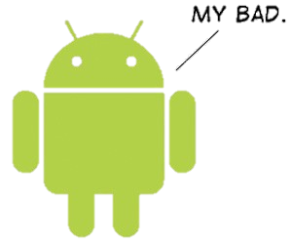
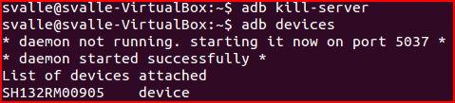
Bad ADB
Android
Forensics
Sometimes adb doesn’t respond properly.
To kill adb, use command adb kill-server

Slide 84

ADB Shell
Android
Forensics
To open an adb shell on an Android device, use command adb shell
  Gives full shell access directly on device.
  Once we learn more about file system and directories, adb shell will get you much of the data needed for forensic analysis
Notes:
DO NOT give out devices. ADB shell can run with emulator.

Slide 85
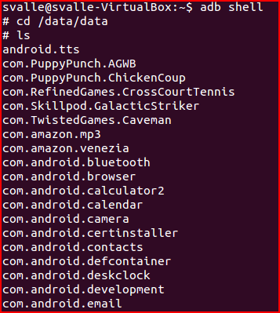
ADB Shell – example
Android
Forensics
    Full list of adb commands at http://developer.android.com/guide/developing/tools/adb.html

Slide 86
REVIEW
Android
Forensics
Learned proper technique for connecting Android device to a forensic workstation
Became familiar with USB Debugging’s importance to forensics
Explored ADB and its relevance to successful investigations

Slide 87
EXERCISE
Android
Forensics
Locate data directory on an Android device
  Connect an Android device to your VM workstation (or startup an AVD)
  Verify USB Debugging is enabled on the device
  Start adb on your forensic workstation
  Using adb shell, locate directories in /data/data
  Jot down the name of some interesting directories for further exploration later

Slide 88
File System
& Data

Slide 89
Forensics Data Gathered and Analyzed
Android
Forensics
To-Do List
File System (physical memory)
  System Files
  Multimedia Files
  Java Files / Executables
  Deleted Data
  Notepad
  More...
GPS Waypoints, Tracks, Routes, etc.
RAM/ROM
Databases
E-mail
SMS History
Deleted SMS
Contacts (stored in phone memory and on SIM card)
Call History
  Received Calls
  Dialed Numbers
  Missed Calls
  Call Dates & Durations
Datebook
Scheduler
Calendar

Slide 90
File System & Data Overview
Android
Forensics
File Systems
Data Storage
What Data?
Important Directories
Five Data Storage Methods
  Shared Preferences
  Internal Storage
  External Storage
  SQLite
  Network
Where else? Linux Kernel & Android Stack
  dmesg
  logcat
Forensically Thinking

Slide 91
File Systems
Android
Forensics
More than a dozen file systems in Android
More than a dozen file systems in use on Android
Forensics analysts should understand the most important
  EXT
  FAT32
  YAFFS2
Most user data live in those
Want to find the file systems on your device?
adb shell cat /proc/filesystems

Slide 92
Data Storage
Android
Forensics
Explore file systems and virtual machines
Learning the Android file systems, directory structures, and specific files will be crucial to successful Android forensics analysis

Slide 93
What Data?
Android
Forensics
Apps shipped with Android (with the OS) – eg. Browser
Apps installed by manufacturer – eg. Moto Blur
Apps installed by wireless carrier – eg. CarrierIQ
Additional Google/Android apps – eg. Google Play Music, Gmail
Apps installed by the user, from Play Store or elsewhere

Slide 94
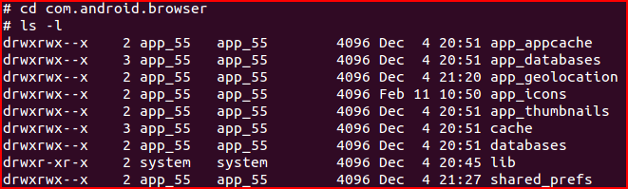
Important Directories
Android
Forensics
/data/data - Apps data generally installed in a subdirectory
Example: Android browser is named com.android.browser, data files are stored at /data/data/com.android.browser

Slide 95
Common Subdirectories
Android
Forensics
/data/data/<app package name>/
shared_prefs | XML of shared preferences
lib | Custom library files required by app
files | Developer saved files
cache | Files cached by the app
databases | SQLite databases and journal files

Slide 96
Five Data Storage Methods
Android
Forensics
We will be exploring these methods
  Shared preferences
  Internal storage
  External storage
  SQLite
  Network

Slide 97

Shared preferences
Android
Forensics
Key-value XML data
use cat command to view files

Slide 98
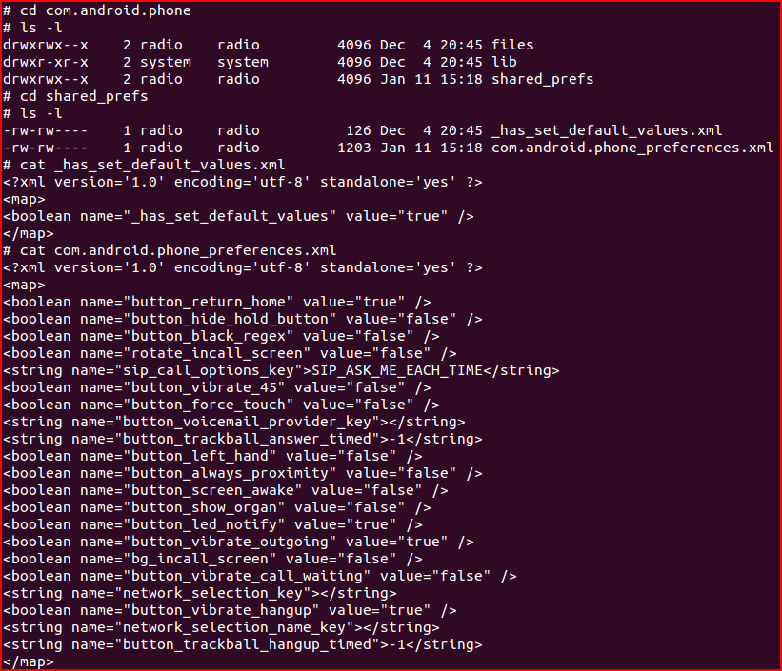
Android
Forensics
Can be source of data

Slide 99
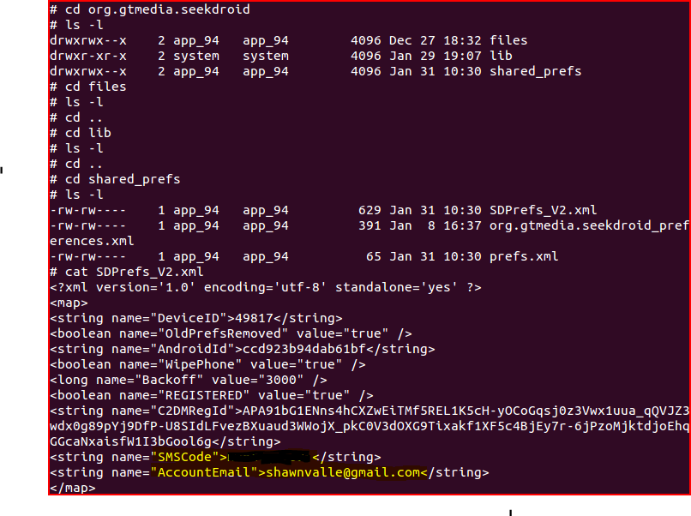
Shared preferences – example
Android
Forensics
Android device security application
Exploring shared_prefs, and SDPrefs_V2.xml, my user name and password are stored in the clear

Slide 100
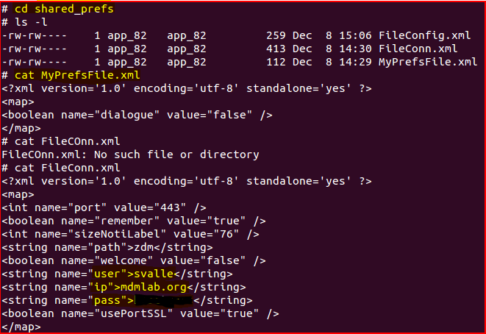
Shared preferences – example
Android
Forensics
MDM product
Stores entire connection string, including user name, domain, and password in clear text

Slide 101
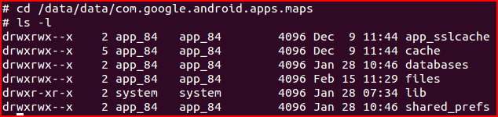
Internal storage
Android
Forensics
Common file systems used: ext3, ext4, yaffs2.
By default, files stored in /data/data are encrypted, accessed only by the application. Commonly root access is needed to access these files.

Slide 102
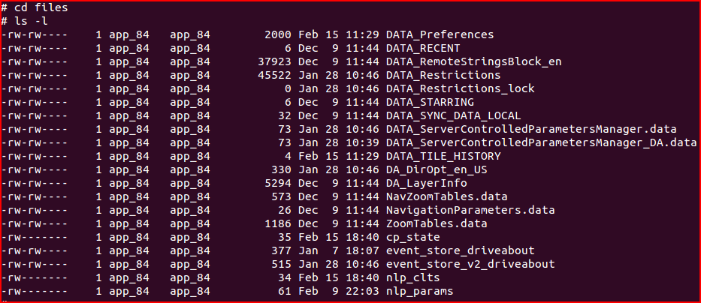
Internal storage
Android
Forensics
Notice user “app_84” is the owner. That user was created when Google Maps was installed
There’s a lot of potential rich forensic maps data in these directories

Slide 103
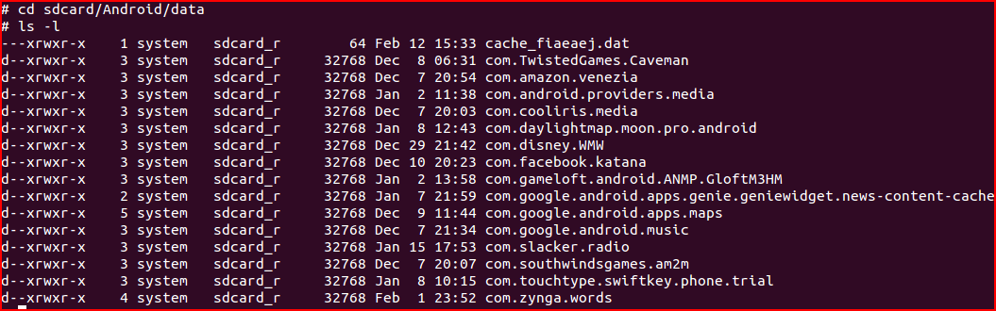
External storage
Android
Forensics
External storage (SD Card) have less permission restrictions.
FAT32 does not have fine-grain permissions of other file systems.
Notes:
Typical use FAT32 as the file system for compatibility with Windows for mounting.
Example: Google Maps will store data on SD Card due to the file size, and that data is easily accessible to a forensic analyst.

Slide 104

SQLite
Android
Forensics
Lightweight open-source relational database
Entire database contained in a single file
Generally stored on internal storage at /data/data/<packageName>/databases
Browser subdirectories contain valuable data

Slide 105
SQLite – commands
Android
Forensics
sqlite3 <database name> Runs SQLite
.tables Lists available tables
.headers ON Displays header row
select * from <table name>; Displays table contents
CTRL+Z Exits SQLite

Slide 106
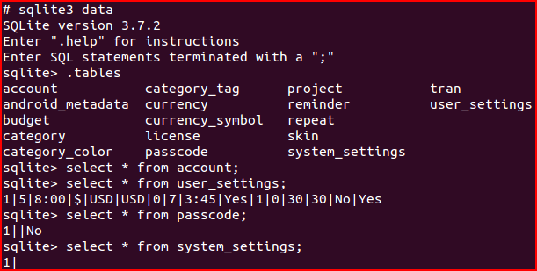
SQLite – example
Android
Forensics
  These directories all contain one of more databases of interesting data for analysis.
  Contents include (app_geolocation) GPS positions for tracking where the device has traveled, (databases, app_databases and app_cache) stored data from visited web sites/apps.
Notes:
Commercial app available in Android Market, Easy Money

Slide 107
Network
Android
Forensics
Network storage via Java and Android network classes
Network data is not stored locally on the device, though configuration files and related databases generally are locally stored

Slide 108
Where else?
Android
Forensics
Linux Kernel & Android Stack
  Android is Linux at the kernel…we know that.
  With Linux, there is a kernel log, which may have some interesting data.
  To access the kernel log, command dmesg or “display message”, prints the kernel messages to the console (avd or adb shell)

Slide 109
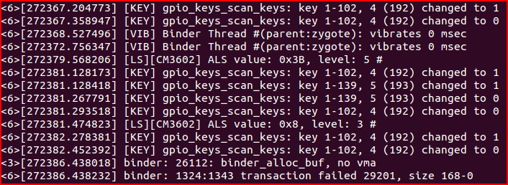
dmesg
Android
Forensics
Notice [KEY] above. Possibly something logging keystrokes. May be worth further investigation
Root access is not needed for dmesg, just USB debugging
Notes:
Generally too much info in dmesg output, though possible time stamps or specific activities may be of use in a forensic investigation.
If the device was recently booted, boot log info may be available.

Slide 110

…more dmesg commands
Android
Forensics
dmesg | wc displays word count of log
–l for line count
dmesg > dmesg.log saves dmesg to a log file
Notes:
Generally too much info in dmesg output, though possible time stamps or specific activities may be of use in a forensic investigation.
If the device was recently booted, boot log info may be available.

Slide 111
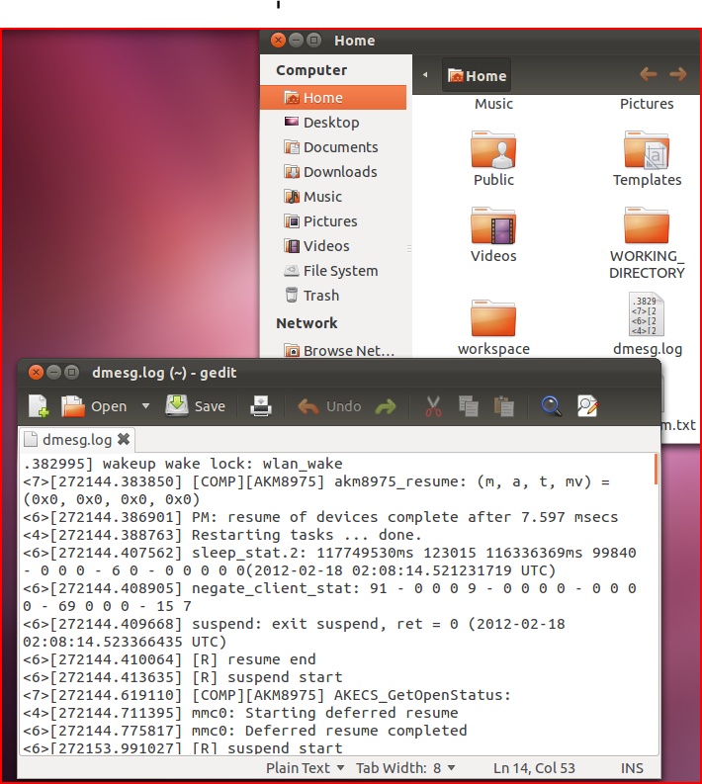
dmesg.log
Android
Forensics
Notes:
Generally too much info in dmesg output, though possible time stamps or specific activities may be of use in a forensic investigation.
If the device was recently booted, boot log info may be available.

Slide 112
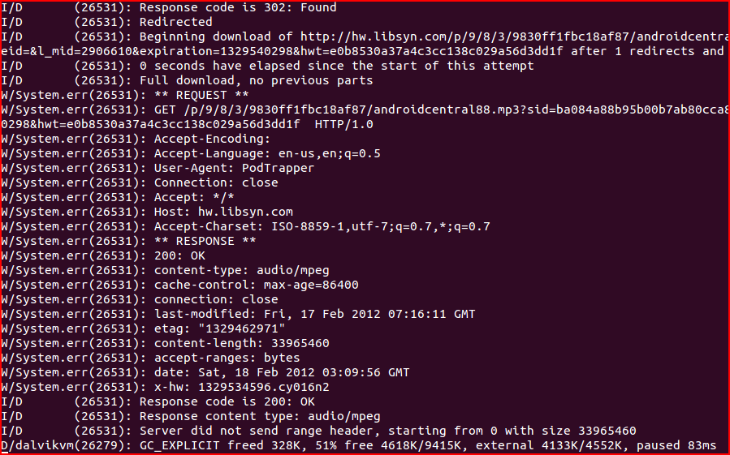
logcat
Android
Forensics
Displays a live stream of messages, system and app debug message
Used in the CarrierIQ demonstration video on YouTube
Notes:
Watch video until 15:45 mark

Slide 113
logcat
Android
Forensics
Message Indicators
Message Indicator | Description
V | Verbose
D | Debug
I | Information
W | Warning
E | Error
F | Fatal
S | Silent

Slide 114
Forensically Thinking
Android
Forensics
Now that we have some idea of how to locate data
Time to start thinking about identifying potential interesting data, forensically thinking
What you might look for:
  Time stamps – when was something modified, when did an event occur
  User Information – locate user names and/or passwords in insecure prefs/logs. Locate user authentication times in log files.
  Image files – identify .JPEG or other picture files, for later assessment of the picture.
  SD Card Files – look for files saved to SD Card
  Call logs – Who has the user been calling / receiving calls from

Slide 115
REVIEW
Android
Forensics
Explored Android file system, internal and external
Located common directories for rich forensic information
Identified five key areas of stored persistent data
Explored application preference files to locate important forensic data
Explored databases in search of data for forensics analysis
Identified sensitive data stored insecurely

Slide 116
EXERCISE
Android
Forensics
Apply current Android forensics knowledge to locate data of interest
  Using adb shell (or /.android if using an AVD), explore an applications shared_prefs within /data/data
  Use the cat command to open an xml file and review the contents
  Note anything of interest to share with the class
  Using sqlite3, explore an applications databases within /data/data
  Use .tables and select commands to gather data of interest, which could identify something specific about the user.
  Note anything of interest to share with the class

Slide 117
Learning Objectives
Android
Forensics
By the end of this course, you will be able to:
Extract and analyze data from an Android device
Manipulate Android file systems and directory structures
Understand techniques to bypass passcodes ^{NEW!}
Utilize logical and physical data extraction techniques
Reverse engineer Android applications
Analyze acquired data

Slide 118

Device Handling
& Modification

Slide 119
Device Handling & Modification
Android
Forensics
Forensics rule: Avoid modification of the target, at all costs
Not so easy for mobile. Drives, RAM, CPU, etc are all in non-accessible locations
Just the act of taking the device out of sleep mode records a log (remember logcat)
The realization: You cannot get a pristine mobile device, but take much precaution to minimize modification to the device
Notes:
Want pristine (or as close to it) evidence as possible, as to not alter forensic data or nullify an investigation.
Plugging in USB, logs an action (which USB access is a key piece to Android forensics)
Network connectivity (automatic email syncing, SMS messages, etc) modifies the device.
Powering off the device, in order to retain network state, may engage passcodes and encryption. Possibly losing the ability for any data acquisition at all.

Slide 120
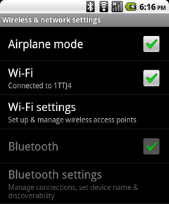
Device Acquisition
Android
Forensics
Extend screen timeout to max, immediately (if not already locked)
Enable Stay Awake while charging and USB debugging
Disable network communication
Do nothing further until in a secure location with minimal cellular / network connectivity
Notes:
Extend
Android 2.3.7 (Gingerbread): Settings > Display > Screen timeout > 30 minutes (other implementations have “Never timeout” option)
Enable
Stay Awake: This will keep the device from shutting off and locking.
USB debugging: enable USB connecting for data extraction.
Android 2.3.7 (Gingerbread): Menu > Settings > Applications > Development > Stay Awake : USB debugging
Disable
Airplane mode (Hold power button or Menu > Settings > Wireless & network settings > Airplane mode)[likely the best approach]
Remove SIM (requires power-off)
Shielded bag, faraday cage (will rapidly drain battery, as device attempts to connect to cellular network)
Power-off, option but not typically advised (may require passcode/PIN upon reboot)

Slide 121
“What if it’s already off?”
Android
Forensics
Boot into recovery mode
Test for connectivity and root access
Cross your fingers that USB debugging is already enabled and/or device is already rooted

Slide 122

Circumventing Passcodes

Slide 123
Circumventing Passcodes
Android
Forensics
Critical capability in forensics and security testing
Techniques vary from platform-to-platform
There is no panacea for circumventing passcodes on Android
  …but we will learn a few potential techniques
Notes:
Learning techniques for circumventing passcodes is critical in forensics and security testing
The techniques vary from platform-to-platform, and even vary among Android devices due to varying versions of the OS and varying manufacture implementations
There is no panacea for circumventing passcodes on Android.
…but we will learn a few potential techniques

Slide 124

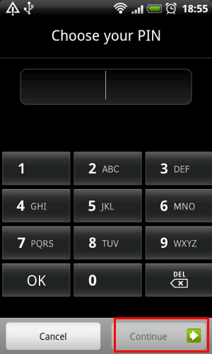

Passcodes Types
Android
Forensics
Pattern lock
PIN
Alphanumeric
Notes:
Four types of passcode on Android
Pattern lock
PIN
Alphanumeric password
Arguably the strongest and most difficult to circumvent
Facial recognition (have not had enough time with ICS yet to evaluate this)

Slide 125

New Passcode Type
Android
Forensics
Facial recognition
Notes:
Four types of passcode on Android
Pattern lock
PIN
Alphanumeric password
Arguably the strongest and most difficult to circumvent
Facial recognition (have not had enough time with ICS yet to evaluate this)

Slide 126
“How Do We Crack Them?”
Android
Forensics
Smudge Attack
Pattern Lock Vulnerability
ADB and USB Debugging, with psneuter
Continues to evolve…
Notes:
ADB and USB Debugging
First attempt requires phone powered on and USB Debugging enabled
Use ADB over USB
On forensics workstation with SDK installed, open command/terminal, and run adb devices
If device is listed, USB Debugging is enabled
Typical verification steps:
adb devices
adb kill-server (if you are sure you are connected, but no devices are listed)

Slide 127
Smudge Attack
Android
Forensics
Screens are reflective; smudge (aka pattern lock) is diffuse.
Directional lighting and a camera capturing photos overexposed by two to three f-stops (4 to 8 times “correct” exposure)
Creates an image displaying pattern lock
Not 100% accurate, since other swipes of the screen may have damaged the pattern lock smudge
Notes:
Adam J. Aviv, Katherine Gibson, Evan Mossop, Matt Blaze, and Jonathan M. Smith, “Smudge Attacks on Smartphone Touch Screens”, Department of Computer and Information Science – University of Pennsylvania

Slide 128


Smudge Attack
Android
Forensics
http://bcove.me/7ozhp9u4
Notes:
WhisperSystems mitigation to smudge attack video
http://bcove.me/7ozhp9u4 Begin at 6:30 mark
We will show what psneuter is in the next section

Slide 129


Pattern Lock Crack
Android
Forensics
Pattern Lock creates a file gesture.key
Hash of the pattern stored
If custom recovery ROM is installed (i.e. ClockWork Recovery)
Remove & recreate key to bypass pattern

Slide 130

Gaining Root
Notes:
Root details
3 types of root
Temp
Perm
Recovery mode
Property Service Neuter (psneuter)
Busy Box
SuperOneClick

Slide 131
Gaining Root
Android
Forensics
Needed for many forensic techniques, including physical acquisition
Not enabled on any device by default
Not possible on all devices
Gaining root isn’t always the best choice in forensics
  It will change data on the device, possibly altering evidence
  It will be time consuming to gain root, as it’s implemented differently across most devices
  Root makes the device vulnerable to many exploits
Notes:
there are many root exploits and they can be stuck in tempfs to reduce the amount of forensic changes – Mark Guido

Slide 132
Three Common Types of Root
Android
Forensics
Temp root – roots the device only until it is rebooted, which then disables root
Perm root – root persists after reboots. Commonly enabled with custom ROMs
Recovery mode root – flashing (installing) a custom recovery partition, allowing root to run only in recovery mode

Slide 133
Temp Root
Android
Forensics
For forensics, temp root is what we want to enable, if needed
Suggest testing these procedures many times, not, on your primary / target device

Slide 134



Temp Root
Android
Forensics
Is USB debugging enabled?
Is it already rooted?
  adb shell su
    permission denied – no root
    # - root
    MyTouch 4G – custom ROM
    Droid X – stock OS
If not rooted, start searching xda-developers.com
Notes:
Just teaching you to fish here. Here’s a pole, there’s the pond, have at it.

Slide 135
Property Service Neuter
Android
Forensics
Psneuter is a form of a malicious app, but for our good
Uses a vulnerability in Android to gain superuser access, and ultimately root
To gain root shell (or temp root) with psneuter:
  adb devices
  adb push psneuter /data/local/tmp
  adb shell
  $ cd /data/local/tmp
  $ chmod 777 psneuter
  $ ./psneuter
Notes:
We don’t yet have access to the psneuter app to push to our device.
It’s available in the web, but even better in a packaged rooting app we will look at in a few mintues

Slide 136

Permanent Root
Android
Forensics
Not as common for forensics
We want to limit the footprint
Perm root leaves a HUGE footprint

Slide 137

Busy Box
Android
Forensics
“The Swiss Army Knife of Embedded Linux”
# mount -o remount,rw -t rfs /dev/block/st19 /system
# exit
adb push busybox /system/bin
adb push su /system/bin
adb install Superuser.apk
adb shell
# chmod 4755 /system/bin/busybox
# chmod 4755 /system/bin/su
# mount -o remount,ro -t rfs /dev/block/st19 /system
# exit
adb reboot
Notes:
Example commands is for Samsung phones
something that you install on Android to give some additional handy LINUX / UNIX based commands
Busy Box is needed to enable permanent root
Need to get Busy Box and superuser.apk to execute this.
With psneuter and the Busy Box / superuser implementation listed, you may gain perm root
…or, check out the next tool as a giant time saver
Remember, we are trying to do forensics here, not learn every intricacy of the Android platform

Slide 138

SuperOneClick
Android
Forensics
A simple tool for "rooting" your Android phone
Notes:
SuperOneClick is a simple tool for "rooting" your Android phone. It allows partial or full rooting and also enables "unrooting.“
Download drivers from your phone
For my Motorola DroidX, drivers are at: http://www.motorola.com/Support/US-EN/Support-Homepage/Software_and_Drivers/USB-and-PC-Charging-Drivers
Windows-based solution (about a 15 minute installation)
Includes ADB in the zip/installation
Home of SuperOneClick: http://shortfuse.org/

Slide 139

SuperOneClick
Android
Forensics
Root for perm, Shell Root for temp
Notes:
SuperOneClick is a simple tool for "rooting" your Android phone. It allows partial or full rooting and also enables "unrooting.“
Download drivers from your phone
For my Motorola DroidX, drivers are at: http://www.motorola.com/Support/US-EN/Support-Homepage/Software_and_Drivers/USB-and-PC-Charging-Drivers
Windows-based solution (about a 15 minute installation)
Includes ADB in the zip/installation
Home of SuperOneClick: http://shortfuse.org/
Video showing successful rooted Moto phone: http://youtu.be/J1MD7GX7Pyw only 1:32 in length

Slide 140
A couple roots
Android
Forensics
Acer A500 http://www.tabletroms.com/forums/showwiki.php?title=AcerIconiaFaq:How-to-root-the-Acer-Iconia-Tab-A500
Lenovo http://rootzwiki.com/topic/8722-lenovo-ideapad-k1-rooting-guide-messy/page__st__120
Notes:
SuperOneClick is a simple tool for "rooting" your Android phone. It allows partial or full rooting and also enables "unrooting.“
Download drivers from your phone
For my Motorola DroidX, drivers are at: http://www.motorola.com/Support/US-EN/Support-Homepage/Software_and_Drivers/USB-and-PC-Charging-Drivers
Windows-based solution (about a 15 minute installation)
Includes ADB in the zip/installation
Home of SuperOneClick: http://shortfuse.org/
Video showing successful rooted Moto phone: http://youtu.be/J1MD7GX7Pyw only 1:32 in length

Slide 141
Agenda
Android
Forensics
DAY 1
Forensic Introduction
Course Setup – Linux, OS X, and Windows
Android Overview
SDK and AVD
Android Security Model
ADB and shell Introduction
File System and Data Structures
Device Handling
Circumvent passcode
Gain Root Access

Slide 142
Agenda
Android
Forensics
DAY 2
Recovery Mode
Boot Loaders
Logical Forensic Techniques
Open Source Tools
Commercial Tools
Physical Forensic Techniques & Tools
Forensic Analysis
Application Penetration Testing Setup
Reverse Apps
…more Reversing
Document Findings

Slide 143
Got sqlite3?
Android
Forensics
$ adb push sqlite3 /sdcard/
$ adb shell
$ su
# mount -o remount,rw -t yaffs2 /dev/block/mtdblock3 /system
# dd if=/sdcard/sqlite3 of=/system/bin/sqlite3
# chmod 4755 /system/bin/sqlite3
# mount -o remount,ro -t yaffs2 /dev/block/mtdblock3 /system
sqlite3 binary is in SuperOneClick directory.
Notes:
Added in for students asking, “how do we install sqlite3 on Motorola devices that do not come with sqlite?” Remember, it’s best to pull data off device and analyze offline to keep the pristine nature during a forensics investigation.

Slide 144

Recovery Mode

Slide 145
Recovery Mode
Android
Forensics
Designed as an avenue for manufacturers to deliver and apply system updates
Recovery partitions offer shell access and root permissions
When booting into recovery mode, pass codes are circumvented
Notes:
Briefly mentioned recovery mode earlier
Not on all stock or manufacture provided ROM’s
Most custom ROM’s and some manufacturer ROM’s contain a recovery partition in the NAND flash
Not all recovery partitions are equal

Slide 146

Recovery Not User Accessible
Android
Forensics
Notes:
Devices without user accessible recovery partition will have a screen similar to this when attempting the recovery mode key combination
Reboot in Recovery (T-Mobile MyTouch 4G with CyanogenMod 7.10 ROM)
Press and hold power off button
Choose Reboot from Phone options menu
Choose Recovery from Reboot phone menu

Slide 147



Recovery User Accessible
Android
Forensics
Check adb devices on forensic workstation
If no adb access, search for root while in recovery mode
Notes:
Phone reboots, ClockworkMod Recovery opens (this is because the phone tested has a custom ROM and custom recovery partition only found on perm rooted phones
# - We have root
$ - we do not have root
Plug into USB (if not already)
Choose “mount” for any of the directories, and you have direct access to the data in that directory, via adb (if connected to forensic workstation) or as a windows directory
Data can be extracted for later analysis
(optional – further ClockworkMod exploration) Navigate to “mounts and storage”

Slide 148
Recovery Mode Techniques
Android
Forensics
Device | Key Combination
Motorola Droid X | Power off. Hold Home and press power button. Release power. When (!) displays release Home. Press Search button. (needs more research)
HTC Incredible | Hold volume down and press power button. Use volume down to select recovery and press power button.
Notes:
Other recovery mode techniques, based on device

Slide 149
Passcode Circumvention Recap
Android
Forensics
If device is on and passcode protected, connect to USB and attempt ADB access.
If pattern lock is present (and you have access to lighting and camera), attempt smudge attack.
If those fail, attempt to reboot into recovery mode.
If device is off, attempt boot into recovery mode.
Notes:
More advanced techniques include flashing the recovery partition with a custom ROM, or utilizing exploits in boot loaders. Many possibilities exist; time limits us from diving into each.

Slide 150
REVIEW
Android
Forensics
Identified the important of proper device handling
Explored techniques for circumventing passcodes
Applied rooting techniques and tools
Located recovery partitions and benefit of recovery mode
Notes:
We won’t be covering boot loaders in detail this course. Android Internals will give you all the Boot Loader info.

Slide 151
EXERCISE
Android
Forensics
Attempt to circumvent passcode and obtain root access
  Document your findings to share with the class

Slide 152
Learning Objectives
Android
Forensics
By the end of this course, you will be able to:
Extract and analyze data from an Android device
Manipulate Android file systems and directory structures
Understand techniques to bypass passcodes ^{NEW!}
Utilize logical and physical data extraction techniques
Reverse engineer Android applications
Analyze acquired data

Slide 153
Android Forensics Techniques

Slide 154
Android Forensics Techniques
Android
Forensics
Forensic data acquisition
Acquiring SD card data
Open-source and commercial forensic tools
  qtADB
  viaExtract
  CelleBrite
  Paraben
Notes:
XRY

Slide 155
Logical vs. Physical Acquisition

Slide 156
Logical vs. Physical Acquisition
Android
Forensics
Logical vs. Physical
Logical
  ADB Pull
  Other tools
Physical
  Hardware vs. software
  Software technique in detail

Slide 157
Logical vs. Physical Acquisition
Android
Forensics
Logical
Physical
Accesses the file system.
Data that is readily available to a user.
Targets the physical memory, not relying on the file systems.
Gains much more data than logical, potentially circumvents passcodes.
Notes:
Logical
If adb devices returns results you can run a logical extraction.
Logical are the most common technique, because they are the easiest and often provide enough data.
No root access needed, just USB debugging
In Android forensics, there is a logical technique which does not rely on the file system, and is less-effective. It relies on applications Content Providers. It is part of Android OS and the SDK. Later on we will have a detailed look at logical forensic techniques, and a commercial tool that uses this technique.
We will look further into adb logical extraction, then into commercial forensic tools, including viaForensics, CelleBrite, and Paraben products
Physical
Physical extraction can be achieved via hardware or software forensics
The ability to physically image memory is the holy grail of mobile device forensics
Hardware-based involves physically tearing down the device, rendering it likely inoperable
Software is a bit less destructive, which we will cover, using root access
Software extraction will attempt to acquire the entire image of the device, including deleted data

Slide 158
Logical Acquisition

Slide 159
Logical SD Card Acquisition
Android
Forensics
User app data lives in /data/data directories which each sub-directory is RW protected to the app user
SD cards are used for large storage (audio, video, maps)
SD uses cross-platform FAT file systems
.apk files residing on SD cards are increasingly encrypted
Removing SD card challenges
Unencrypted .apk’s are mounted in /mnt/asec
  This is an important directory to pull and analyze, if 3rd party apps are part of the investigation
Notes:
X-platform
FAT file system, common on old versions of Windows
Encrypted apk
limiting the previous ability to lift the .apk off device and analyze
microSD range from 2GB to 32GB
Removing challenges
Physically removing SD cards sometimes requires removing battery (i.e. powering off), or becoming more common, the SD card is non-removable
Unencrypted
When SD card is not mounted to forensic workstation, the unencrypted .apk’s are mounted in /mnt/asec.
This a an important directory to pull and analyze, if 3rd party apps are part of the investigation
We will look at reverse engineering the .apk files later

Slide 160
ADB Pull – logical
Android
Forensics
Command used for copying data from an emulator or device
Primary logical acquisition tool
adb pull on non-rooted Droid X:
Notes:
If not ‘rooted’ will likely not have much for results
You may notice security engineers talk about the importance of not rooting your Android device. This is the reason
adb pull is considered a primary logical acquisition tool
May take 20 minutes to complete

Slide 161


ADB Pull – rooted & locked
Android
Forensics
adb pull on rooted and password locked HTC Glacier (aka T-Mobile MyTouch 4G):
Notes:
If not ‘rooted’ will likely not have much for results
You may notice security engineers talk about the importance of not rooting your Android device. This is the reason
adb pull is considered a primary logical acquisition tool
May take 20 minutes to complete

Slide 162



ADB Pull – rooted & locked
Android
Forensics
~700 MB
~27 minutes
Notes:
The entire /data directory was pulled from the MyTouch, while locked, and stored on my workstation in /home/adbpull
On unrooted devices, /data is encrypted,
though adb pull can pull useful data (web history, system info, more) in directories like /proc and /sys.
Later on we will dig into some of the key directories we pulled data from

Slide 163



Tools and Time Savers
Notes:
Many commercial forensics software products, now support Android (likely because the ease of adb integration)
Not all are equal, as there are hundreds of Android devices which each product may (or may not) support
Most focus on logical acquisition of data either with adb or pulling Content Provider information from applications
Some can do physical acquisition on a few devices
Some also attempt passcode bypassing
http://viaforensics.com/products/viaextract/
The Sleuth Kit http://sleuthkit.org
We will look at
QtADB
AFLogical by viaForensics
Cellebrite UFED & Physical Analyzer
Paraben Device Seizure

Slide 164

QtADB
Android
Forensics
http://qtadb.wordpress.com/
Graphical app based on adb
Open-source, currently well-supported
Notes:
A graphical app based on adb.
Utilizes the Android SDK (actually uses adb), but gives a clean user interface
Requires installing Qt libs 4.7 on your workstation, rooted device, and busybox installed on the device
Windows, Linux, and Mac versions
Silent annotated 6 minute video: http://youtu.be/H3drxktKIyU

Slide 165
QtADB – features
Android
Forensics
File manager
  copying files and dirs between phone and computer
  removing files and dirs
  creating new dir
  and other
App manager
  installing apps
  removing apps
  creating backup of apps with data
  restoring backups of apps with data
Sms manager
  receiving sms (baloon in tray)
  reading sms
  sending sms
Shell
  opens android shell
Screenshot
  take screenshot of your device
  save screenshot to png file
Fastboot
  flash bootloader, radio and recovery
  boot recovery
Recovery
  nandroid backup/restore
  wipe data
  flash rom
  wipe battery stats
  fix uid mismatches
Reboot
  to bootloader
  to recovery
  normal reboot
Settings
  set font used by app
  set starting paths (or remember paths on exit)
  and other
Logcat
Automatically detects phone (device, fastboot and recovery mode)
Notes:
A graphical app based on adb. Utilizes the Android SDK (actually uses adb), but gives a clean user interface
Open-source, currently well-supported
Requires installing Qt libs 4.7 on your workstation, rooted device, and busybox installed on the device
Windows, Linux, and Mac versions

Slide 166


QtADB – in action
Android
Forensics
Recovery partition
Logcat

Slide 167

QtADB – setup
Android
Forensics
Windows:
  Must have Android SDK installed
  ZIP contain all libraries
  Extract to a permanent directory
  Open QtADB application
  Choose path to directory with adb and aapt binaries (example: C:\Users\<USERNAME>\AppData\Local\Android\android-sdk\platform-tools)
Notes:
Windows: http://qtadb.com/qtadb/QtADB_0.8.1_windows.zip
Linux 64-bit: http://qtadb.com/qtadb/QtADB_0.8.1_linux64.tar.gz
Mac OS X: http://www.mediafire.com/file/4hsyfnvvmq2lc5c/QtADB_0.8.0_osx.zip
If phone drivers are installed, QtADB will display a Windows Explorer-like display
Workstation files on left, phone files on right

Slide 168
REVIEW
Android
Forensics
Identified the difference between logical and physical forensics
Explored open and free tools and techniques for logically acquiring data
Located directories and file details for SD card logical acquisition

Slide 169
EXERCISE
Android
Forensics
Using either ADB or QtADB pull a logical acquisition from your device or AVD.
Verify pull successfully completed, and document size of data acquired.

Slide 170

AFLogical
Android
Forensics
Android forensics logical extraction tool
Free for law enforcement and government agencies
Leverages
Content
Providers
CallLog Calls
Notes:
Created by security consulting / product company viaForensics
Leverages Content Providers (remember our overview of the Android security model).
Content Providers allows an application the ability to share data with another application.
See Intro to Android Dev for more.
AFLogical requires USB debugging to be enabled
Acquires data from 41 Content Providers and saves details in .csv
Setup:
Download AFLogical application at http://viaforensics.com/products/aflogical/
Remove users’ SD Card and install examiners SD Card into phone
Connect Android device to forensic workstation
From cmd prompt, type the following:
adb devices
adb install AndroidForensics.apk
adb shell am start -n com.viaforensics.android/com.viaforensics.android.ForensicsActivity
On device, viaForensic app should be running, select Capture
[Optional] Create directory on workstation to receive files, for example c:\temp\af
[Optional] From cmd prompt:
adb pull /sdcard/forensics c:\temp\af
From cmd prompt:
adb uninstall com.viaforensics.android
Disconnect Android device
Files are on SD Card root in folder called forensics and then named after date/time of acquisition. Or files are in workstation folder if followed above Optional steps.

Slide 171


Cellebrite UFED
Android
Forensics
Notes:
Logical extraction only
No deleted files
No file system at all
Data extracted
SMS
Call Log
Contacts
Pictures
Audio Files
Etc.
~1-2 min for extraction

Slide 172
Cellebrite Physical Analyzer
Android
Forensics

Slide 173


Paraben Device Seizure
Android
Forensics
Notes:
Logical Extraction
SMS
Call Log
Contacts
Pictures
Audio Files
Etc.
File System
No deleted files
Reconstructs file system
Excludes /data
Regular user does not have permission to access this directory
Next step: root the device
~3-4 hours for extraction
We will look at:
Acquisition
Results
Sorting
Reporting

Slide 174

Device Seizure – Acquisition
Android
Forensics
DS acquisition temp installs Seizure Service on device. Removes automatically during completion of acquisition
Notes:
Logical Extraction
SMS
Call Log
Contacts
Pictures
Audio Files
Etc.
File System
No deleted files
Reconstructs file system
Excludes /data
Regular user does not have permission to access this directory
Next step: root the device
~3-4 hours for extraction

Slide 175

Device Seizure – Acquisition
Android
Forensics
Device Seizure hung while acquiring data after more than 11 hours
Keep in mind, I'm acquiring from a rooted CyanogenMod ROM, and checked options to acquire all data, including the entire contents of 32GB Class 10 microSD card

Slide 176

Device Seizure – Acquisition
Android
Forensics
This screen displays for considerable amount of time when completing / canceling an acquisition

Slide 177

Device Seizure – Results
Android
Forensics
Contacts and Calendar were empty

Slide 178

Device Seizure – Sorting
Android
Forensics
After acquisition, "Do you want to fill the sorter?“
This will take about an hour

Slide 179

Device Seizure – Sort Results
Android
Forensics
Sorting all the findings
Notes:
5-48 hours, eventual failure to complete. Though looking at data, nearly 3GB of data was extracted into case. (case3)
Stored on protected IronKey
Search for “password”
28 results found before pausing search
Cached GPS voice commands
HTC Glacier → File System → mnt/sdcard/Android/data/com.google.android.apps.maps/cache/._speech_nav_27.wav[1}
I-95 N , 2011-12-09 11:47:00
mnt/sdcard/Android/data/com.google.android.apps.maps/cache/._speech_nav_13.wav[1}
Wayside Rd. , 2011-12-09 11:55:24
Image Investigation
HTC Glacier → File System → mnt/sdcard/DCIM/.thumbnails/1324772457133.jpg [1]
Picture of room with furniture. Meta data shows picture was taken from HTC Glacier on 2011-12-24 20:20:56.

Slide 180

Device Seizure – Reports
Android
Forensics
Creating a PDF report of the entire case

Slide 181

Device Seizure – Report
Android
Forensics

Slide 182
Device Seizure – Report
Android
Forensics

Slide 183

Device Seizure – Report
Android
Forensics

Slide 184
Physical Acquisition
Notes:
Physical – Accesses the physical storage, not the file system, for access to data.
Physical provides much more data than logical, though are more difficult and time intensive, and require more analysis time.
Can locate deleted data, which was marked for deletion, but not yet overwritten.
Known as allocated and unallocated (deleted) data.

Slide 185
Software Physical Acquisition
Android
Forensics
Let’s get a full NAND acquisition of the user accessible data partition
For time’s sake, and now that we know of open-source and commercial tools, let’s take advantage of them for the physical acquisition
Notes:
Physical more difficult to achieve than logical.
First need root privileges, we covered this earlier. No root, no physical.
If we have root, we can get access to the entire NAND flash, not just the file system
Will bypass passcode locked devices
How do we do it?
Many approaches documented

Slide 186
Forensic Analysis

Slide 187
Forensic Analysis
Analyzing acquired data
  File System Analysis
  SQLite Analysis
  Directory Structure
  FAT Analysis
  SD Card Analysis
  YAFFS2 Analysis

Slide 188

Forensic Analysis - photos
Common location for storage of photos in JPG format

Slide 189
Important Directories Recap
Android
Forensics
/cache/
  Previewed Gmail attachments
  Downloads (Market and messages)
/data/
    dalvik-cache: applications (.dex) that have been run
    app: .apk files
    data: subdirectories per app with SQLite databases and XML shared preferences
    misc: protocol info
    system:
      installed applications (or packages.xml)
      accounts database
      device and app login details, .key files
/proc & /sys – list of device filesystems, web history, device info
/mnt/sdcard/DCIM/Camera - images
/sdcard/android or sdcard/data/data – FAT32, limited permission

Slide 190
REVIEW
Explored several commercial Android forensics products
Identified the benefits and acquisition steps of physical forensics
Located the most important directories for analysis

Slide 191
EXERCISE
Determine what the user does for work and fun
  (in groups) Now that you have acquired data many different ways, analyze the data using one of the forensics tools (adb, adb shell, Device Seizure, QtADB, etc) to get a fresh data acquisition from your device
  Look at earlier exercises for commands, as a refresher
  Explore data in directories like /data/ and /cache/
  As a forensic analyst, document findings that would help you determine the users profession and hobbies
  Be prepared to share your findings with the class
Notes:
If using AFLogical (see exercise page for AFLogical setup)
Connect an Android device and attempt a physical acquisition (if available)
If physical not available, attempt a logical acquisition (for time sake, exclude SD card)
Once acquired, locate apps and be prepared to share with the class the contacts database and apps stored on the device

Slide 192
Learning Objectives
Android
Forensics
By the end of this course, you will be able to:
Extract and analyze data from an Android device
Manipulate Android file systems and directory structures
Understand techniques to bypass passcodes
Utilize logical and physical data extraction techniques
Reverse engineer Android applications
Analyze acquired data

Slide 193

Application Testing
Reverse Engineering Apps

Slide 194


Analyzing APKs
Android
Forensics
Byte code is reverted to source
First extracting each of the classes.dex files
Using dex2jar.bat, a jar file is created
Batch file used to convert dex files to jar files
.dex
dx
.class
java
.java
Notes:
The byte code is reverted to source for potential use during penetration testing
This is done by first extracting each of the classes.dex files using an archive manager, for example 7-Zip
Archive management program similar to WinZip
Using dex2jar.bat, a jar file is created
Batch file used to convert dex files to jar files

Slide 195
More Analyzing APKs
Android
Forensics
Java Decompiler used to create a zip file containing all of the Java source code
  Used to view class files and convert them to java
The remaining content of each of the APK files is extracted
Yes, it’s a painful process!
How can we make it easier?
Notes:
The byte code is reverted to source for potential use during penetration testing
This is done by first extracting each of the classes.dex files using an archive manager, for example 7-Zip
Archive management program similar to WinZip
Using dex2jar.bat, a jar file is created
Batch file used to convert dex files to jar files

Slide 196

APK Reversing
Rename Android app (.apk) to .zip.
Extract .zip.
Run Dex2Jar desktop script (.bat or .sh) on extracted .dex file
Dex2Jar decompiles .dex to .jar (Java Archive)
Open .jar in Java Decompiler desktop app to review source
.dex
dx
.class
java
.java

Slide 197



APKTool
Android
Forensics
Powerful tool for forensic analysts
Tool for reverse engineering Android binaries
Available at code.google.com
Notes:
Remove -f flag if not needing to overwrite directory.
Installation for noobs
Windows:
Download apktool-install-windows-* file
Download apktool-* file
Unpack both to your Windows directory
Linux:
Download apktool-install-linux-* file
Download apktool-* file
Unpack both to /usr/local/bin directory (you must have root permissions)
Mac OS X:
Download apktool-install-macos-* file
Download apktool-* file
Unpack both to /usr/local/bin directory (you must have root permissions)

Slide 198


androguard
Android
Forensics
Reverse engineering, Malware and goodware analysis of Android applications ... and more !
Check for permissions and usage
Available at code.google.com
Notes:
you can analyze, display, modify and save your apps easily and statically by using the tool (androlyze) in command line

Slide 199


APKinspector
Android
Forensics
Powerful tool for forensic analysts
Graphically reverse engineer and analyze apps
Available at code.google.com
Notes:
Includes Java Decompiler and dex2jar
APKInspector install steps
Code.google.com/p/apkinspector/wiki/Installation (with help from ubuntuforums.org/showthread.php?t=17777613)
Install QtSDK
Configure PATH
Install Python
Install SIP
Install PyQt4
Install pydot
Install Graphviz
Install apktool
Run it: /opt/apkinspector python startQT.py
No sound, not stimulating 9:00m Video at: http://youtu.be/X538N-x3UUY

Slide 200
REVIEW
Explored reversing tools for Android
Reverse engineered app back to source code
Explored code and data for an APK

Slide 201
EXERCISE
Reverse engineer an app and locate critical data
  Use APKInspector
  Reverse engineer Facebook or F-Droid, mobile app market, application
    Both apps located in Documents directory on workstation
  Locate the database where user ID’s are stored

Slide 202
Learning Objectives
Android
Forensics
By the end of this course, you will be able to:
Extract and analyze data from an Android device
Manipulate Android file systems and directory structures
Understand techniques to bypass passcodes ^{NEW!}
Utilize logical and physical data extraction techniques
Reverse engineer Android applications
Analyze acquired data

