Slide 1
Introduction to Intel x86-64 Assembly, Architecture, Applications, & Alliteration
Xeno Kovah – 2014-2015
xeno@legbacore.com

Slide 2
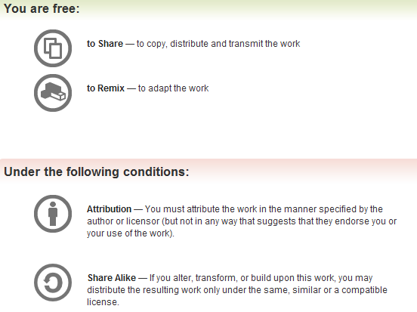
All materials is licensed under a Creative Commons “Share Alike” license.
http://creativecommons.org/licenses/by-sa/3.0/
Attribution condition: You must indicate that derivative work
"Is derived from Xeno Kovah's 'Intro x86-64’ class, available at http://OpenSecurityTraining.info/IntroX86-64.html”
Notes:
Attribution condition: You must indicate that derivative work
"Is derived from Xeno Kovah's ‘Intro x86-64’ class, available at http://OpenSecurityTraining.info/IntroX86-64.html"

Slide 3
LetErRIP.c
//LetErRIP.c
char someGlobal = 0;
short main(){
char a = 1;
someGlobal = a;
return 22;
}
RIP-relative Addressing
main:
0000000140001000 48 83 EC 18 sub rsp,18h
0000000140001004 C6 04 24 01 mov byte ptr [rsp],1
0000000140001008 0F B6 04 24 movzx eax,byte ptr [rsp]
000000014000100C 88 05 EE 44 06 00 mov byte ptr [40065500h],al
0000000140001012 B8 16 00 00 00 mov eax,16h
0000000140001017 48 83 C4 18 add rsp,18h
000000014000101B C3 ret
main:
0000000140001000 48 83 EC 18 sub rsp,18h
0000000140001004 C6 04 24 01 mov byte ptr [rsp],1
0000000140001008 0F B6 04 24 movzx eax,byte ptr [rsp]
000000014000100C 88 05 EE 44 06 00 mov byte ptr [someGlobal (0140065500h)],al
0000000140001012 B8 16 00 00 00 mov eax,16h
0000000140001017 48 83 C4 18 add rsp,18h
000000014000101B C3 ret

Slide 4
LetErRIP.c
//LetErRIP.c
char someGlobal = 0;
short main(){
char a = 1;
someGlobal = a;
return 22;
}
RIP-relative Addressing
Takeaways:
Visual Studio 2012 displays RIP-relative addresses misleadingly!
64 bit bug I think. View with symbols to see the accurate address
(Some students said this was fixed in VS 2015)
main:
0000000140001000 48 83 EC 18 sub rsp,18h
0000000140001004 C6 04 24 01 mov byte ptr [rsp],1
0000000140001008 0F B6 04 24 movzx eax,byte ptr [rsp]
000000014000100C 88 05 EE 44 06 00 mov byte ptr [40065500h],al
0000000140001012 B8 16 00 00 00 mov eax,16h
0000000140001017 48 83 C4 18 add rsp,18h
000000014000101B C3 ret
main:
0000000140001000 48 83 EC 18 sub rsp,18h
0000000140001004 C6 04 24 01 mov byte ptr [rsp],1
0000000140001008 0F B6 04 24 movzx eax,byte ptr [rsp]
000000014000100C 88 05 EE 44 06 00 mov byte ptr [someGlobal (0140065500h)],al
0000000140001012 B8 16 00 00 00 mov eax,16h
0000000140001017 48 83 C4 18 add rsp,18h
000000014000101B C3 ret

Slide 5
LetErRIP.c
//LetErRIP.c
char someGlobal = 0;
short main(){
char a = 1;
someGlobal = a;
return 22;
}
RIP-relative Addressing
On Linux:
00000000004004ed <main>:
4004ed: 55 push %rbp
4004ee: 48 89 e5 mov %rsp,%rbp
4004f1: c6 45 ff 01 movb $0x1,-0x1(%rbp)
4004f5: 0f b6 45 ff movzbl -0x1(%rbp),%eax
4004f9: 88 05 3a 0b 20 00 mov %al,0x200b3a(%rip) # 601039 <someGlobal>
4004ff: b8 16 00 00 00 mov $0x16,%eax
400504: 5d pop %rbp
400505: c3 retq
More clearly RIP-relative
Helpful math of next instruction (0x4004FF) + displacement (0x200B3A) = 0x601039

