Slide 1
Introduction to Intel x86-64 Assembly, Architecture, Applications, & Alliteration
Xeno Kovah – 2014
xkovah at gmail

Slide 2
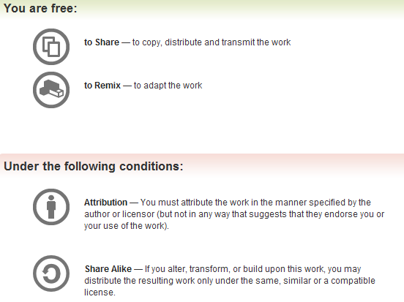
All materials is licensed under a Creative Commons “Share Alike” license.
http://creativecommons.org/licenses/by-sa/3.0/
Attribution condition: You must indicate that derivative work
"Is derived from Xeno Kovah's 'Intro x86-64’ class, available at http://OpenSecurityTraining.info/IntroX86-64.html”
Notes:
Attribution condition: You must indicate that derivative work
"Is derived from Xeno Kovah's ‘Intro x86-64’ class, available at http://OpenSecurityTraining.info/IntroX86-64.html"

Slide 3
SingleLocalVariable.c
Adding a single local variable
//SingleLocalVariable.c:
int func(){
int i = 0xbeef;
return i;
}
int main(){
return func();
}
func:
0000000140001000 sub rsp,18h
0000000140001004 mov dword ptr [rsp],0BEEFh
000000014000100B mov eax,dword ptr [rsp]
000000014000100E add rsp,18h
0000000140001012 ret
main:
0000000140001020 sub rsp,28h
0000000140001024 call func (0140001000h)
0000000140001029 add rsp,28h
000000014000102D ret

Slide 4
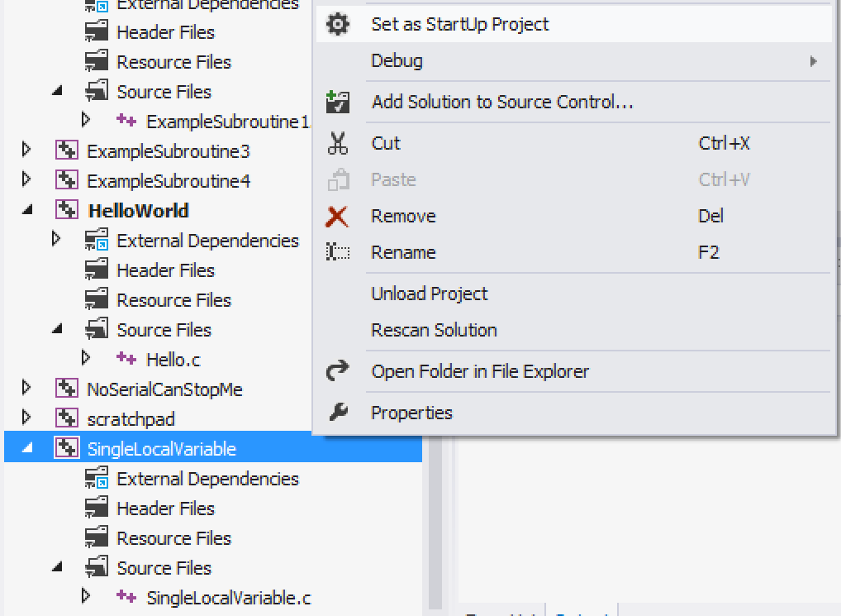
Don’t forget to change the next project to the StartUp project as you’re moving between labs!

Slide 5
Based on the asm, we can infer the stack looks like this at line 000000014000100B in func()
00000000`0012FEB8 | return address = 00000001`40001029
… | undef
00000000`0012FE78 | undef
00000000`0012FE70 | undef`0000BEEF
Because the asm only wrote a “dword ptr” (4 bytes) worth of memory at this location, so the top 4 bytes are undefined
0x18 bytes
RSP

Slide 6
SingleLocalVariable.c takeaways
Local variables lead to an allocation of space on the stack, within the function where the variable is scoped to
In VS (when optimization is turned off), there is an over-allocation of space for local variables
0x18 reserved for only 0x4 (int) worth of data
//SingleLocalVariable.c:
int func(){
int i = 0xbeef;
return i;
}
int main(){
return func();
}
func:
sub rsp,18h
mov dword ptr [rsp],0BEEFh
mov eax,dword ptr [rsp]
add rsp,18h
ret
main:
sub rsp,28h
call func (0140001000h)
add rsp,28h
ret

Slide 7
ArrayLocalVariable.c
Adding and accessing an array local variable
main:
0000000140001000 sub rsp,28h
0000000140001004 mov dword ptr [rsp],100Dh
000000014000100B mov qword ptr [rsp+8],0D00Dh
0000000140001014 mov eax,2
0000000140001019 imul rax,rax,1
000000014000101D movzx ecx,word ptr [rsp]
0000000140001021 mov word ptr [rsp+rax+10h],cx
0000000140001026 mov eax,2
000000014000102B imul rax,rax,1
000000014000102F movsx eax,word ptr [rsp+rax+10h]
0000000140001034 movsx ecx,word ptr [rsp+8]
0000000140001039 add eax,ecx
000000014000103B mov ecx,2
0000000140001040 imul rcx,rcx,4
0000000140001044 mov word ptr [rsp+rcx+10h],ax
0000000140001049 mov eax,2
000000014000104E imul rax,rax,4
0000000140001052 movsx eax,word ptr [rsp+rax+10h]
0000000140001057 add rsp,28h
000000014000105B ret
//ArrayLocalVariable.c:
short main(){
int a;
short b[6];
long long c;
a = 0x100d;
c = 0xd00d;
b[1] = (short)a;
b[4] = b[1] + (short)c;
return b[4];
}

Slide 8
9
IMUL - Signed Multiply
FYI, Visual Studio seems to have a predilection for imul over mul (unsigned multiply). You’ll see it showing up in places you expect mul.
I haven’t been able to get it to generate the latter for simple examples.
Three forms. One, two, or three operands
imul r/mX edx:eax = eax * r/mX
imul reg, r/mX reg = reg * r/mX
imul reg, r/mX, immediate reg = r/mX * immediate
Three operands? Possibly the only “basic” instruction (meaning non-added-on-instruction-set(MMX,AVX,AEX,VMX,etc)) of it’s kind? (see link in notes)
Book p. 218
Notes:
http://www.microsoft.com/msj/0698/hood0698.aspx - “There's even a form of the IMUL instruction that takes three operands. To my knowledge, this is the only instruction in the Intel opcode set with this distinction.”
I found that quote while trying to find a way to make visual studio naturally emit a MUL instruction. Also, while things containing an r/mX can encode a mnemonic which looks like is has more operands, the information is still contained in a the normal combo of one or two bytes

Slide 9
IMUL - examples
edx | eax | r/mX(ecx)
0x0 | 0x44000000 | 0x4
rax | r/mX(rcx)
0x20 | 0x4
rax | r/mX(rcx)
0x20 | 0x4
initial
operation
imul ecx
imul rax, rcx
imul rax, rcx, 0x6
edx | eax | r/mX(ecx)
0x1 | 0x10000000 | 0x4
rax | r/mX(rcx)
0x80 | 0x4
rax | r/mX(rcx)
0x18 | 0x4
result
Book p. 218

Slide 10
10
MOVZX - Move with zero extend
MOVSX - Move with sign extend
11
Used to move small values (from smaller types) into larger registers (holding larger types)
Support same r->r, r->m, m->r, i->m, i->r forms as normal MOV
“Zero extend” means the CPU unconditionally fills the high order bits of the larger register with zeros
“Sign extend” means the CPU fills the high order bits of the destination larger register with whatever the sign bit is set to on the small value
Book p. 169-172

Slide 11
MOVZX/MOVSX - examples
mov eax, 0xF00DFACE
movzx rbx, eax
now rbx = 0x00000000F00DFACE
movsx rbx, eax
now rbx = 0xFFFFFFFFF00DFACE, because the sign bit (most significant bit) of 0xF00DFACE is 1

Slide 12
Based on the asm, we can infer the stack looks like this at line 0000000140001049 of main():
00000000`0012FEB8 | return address = 000000014000131d
… | undef
00000000`0012FEAC | undef
00000000`0012FEAA | short b[5] = undef
00000000`0012FEA8 | short b[4] = maths!
00000000`0012FEA6 | short b[3] = undef
00000000`0012FEA4 | short b[2] = undef
00000000`0012FEA2 | short b[1] = maths!
00000000`0012FEA0 | short b[0] = undef
00000000`0012FE98 | long long c = 0xd00d
00000000`0012FE90 | int a = 0x100d
0x28 bytes
I’m cheating here and not using only 0x8-sized entries, for clarity
I’m cheating here and not using only 0x8-sized entries, for clarity
I’m cheating here and not using only 0x8-sized entries, for clarity of array indices’ address
Note how there’s wasted space by storing a 4 byte value (“int a”) in an 8 byte space
RSP

Slide 13
ArrayLocalVariable.c takeaways
Local variables need not be stored on the stack in the same order they are defined in the high level language
(In VS unoptimized code) Array access is typically done by multiplying the size of the array element (2 bytes for a short in this case), times the index that is desired to be access (indices 1 and 4 in this case)
Moving a small value to a large register will result in a zero extend. Addition using signed values could result in a sign extend, if the arithmetic is done in a larger register
main:
sub rsp,28h
mov dword ptr [rsp],100Dh
mov qword ptr [rsp+8],0D00Dh
mov eax,2
imul rax,rax,1
movzx ecx,word ptr [rsp]
mov word ptr [rsp+rax+10h],cx
mov eax,2
imul rax,rax,1
movsx eax,word ptr [rsp+rax+10h]
movsx ecx,word ptr [rsp+8]
add eax,ecx
mov ecx,2
imul rcx,rcx,4
mov word ptr [rsp+rcx+10h],ax
mov eax,2
imul rax,rax,4
movsx eax,word ptr [rsp+rax+10h]
add rsp,28h
ret
//ArrayLocalVariable.c:
short main(){
int a;
short b[6];
long long c;
a = 0x100d;
c = 0xd00d;
b[1] = (short)a;
b[4] = b[1] + (short)c;
return b[4];
}

Slide 14
StructLocalVariable.c
Accessing a struct local variable
main:
0000000140001000 sub rsp,28h
0000000140001004 mov dword ptr [rsp],100Dh
000000014000100B mov qword ptr [rsp+10h],0D00Dh
0000000140001014 mov eax,2
0000000140001019 imul rax,rax,1
000000014000101D movzx ecx,word ptr [rsp]
0000000140001021 mov word ptr [rsp+rax+4],cx
0000000140001026 mov eax,2
000000014000102B imul rax,rax,1
000000014000102F movsx rax,word ptr [rsp+rax+4]
0000000140001035 add rax,qword ptr [rsp+10h]
000000014000103A mov ecx,2
000000014000103F imul rcx,rcx,4
0000000140001043 mov word ptr [rsp+rcx+4],ax
0000000140001048 mov eax,2
000000014000104D imul rax,rax,4
0000000140001051 movzx eax,word ptr [rsp+rax+4]
0000000140001056 add rsp,28h
000000014000105A ret
//StructLocalVariable.c:
typedef struct mystruct{
int a;
short b[6];
long long c;
} mystruct_t;
short main(){
mystruct_t foo;
foo.a = 0x100d;
foo.c = 0xd00d;
foo.b[1] = foo.a;
foo.b[4] = foo.b[1] + foo.c;
return foo.b[4];
}

Slide 15
Based on the asm, we can infer the stack looks like this:
00000000`0012FEB8 | return address = 000000014000131d
... | undef
00000000`0012FEA8 | undef
00000000`0012FEA0 | long long c = 0xd00d
00000000`0012FE9E | short b[5] = undef
00000000`0012FE9C | short b[4] = undef
00000000`0012FE9A | short b[3] = undef
00000000`0012FE98 | short b[2] = undef
00000000`0012FE96 | short b[1] = maths!
00000000`0012FE94 | short b[0] = undef
00000000`0012FE90 | int a = 0x100d
0x28 bytes
Note how there’s no wasted space this time since the “int a” 4 byte value is next to the 6 short 2 byte values, which all added up just happen to be 4 shy of 16 bytes total. Hence why c is accessed with “[rsp+10h]”
I’m cheating here and not using only 0x8-sized entries, for clarity
I’m cheating here and not using only 0x8-sized entries, for clarity
I’m cheating here and not using only 0x8-sized entries, for clarity of array indices’ address
RSP

Slide 16
StructLocalVariable.c
Fields in a struct must be stored in the same order they are defined in the high level language. And they will appear with the first field at the lowest address, and all subsequent fields higher.
//StructLocalVariable.c:
typedef struct mystruct{
int a;
short b[6];
long long c;
} mystruct_t;
short main(){
mystruct_t foo;
foo.a = 0x100d;
foo.c = 0xd00d;
foo.b[1] = foo.a;
foo.b[4] = foo.b[1] + foo.c;
return foo.b[4];
}
main:
sub rsp,28h
mov dword ptr [rsp],100Dh
mov qword ptr [rsp+10h],0D00Dh
mov eax,2
imul rax,rax,1
movzx ecx,word ptr [rsp]
mov word ptr [rsp+rax+4],cx
mov eax,2
imul rax,rax,1
movsx rax,word ptr [rsp+rax+4]
add rax,qword ptr [rsp+10h]
mov ecx,2
imul rcx,rcx,4
mov word ptr [rsp+rcx+4],ax
mov eax,2
imul rax,rax,4
movzx eax,word ptr [rsp+rax+4]
add rsp,28h
ret

Slide 17
Instructions we now know (11)
NOP
PUSH/POP
CALL/RET
MOV
ADD/SUB
IMUL
MOVZX/MOVSX

