Slide 1
Introduction to Intel x86-64 Assembly, Architecture, Applications, & Alliteration
Xeno Kovah – 2014
xkovah at gmail

Slide 2
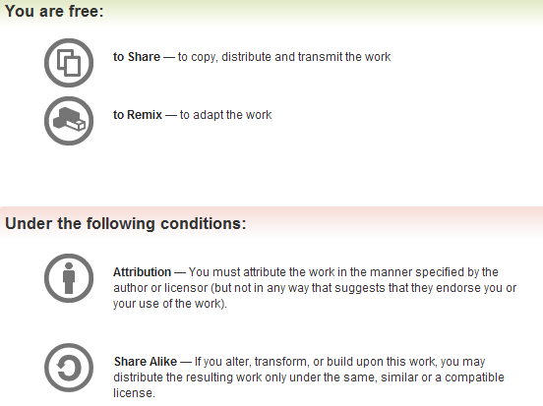
All materials is licensed under a Creative Commons “Share Alike” license.
http://creativecommons.org/licenses/by-sa/3.0/
Attribution condition: You must indicate that derivative work
"Is derived from Xeno Kovah's 'Intro x86-64’ class, available at http://OpenSecurityTraining.info/IntroX86-64.html”
Notes:
Attribution condition: You must indicate that derivative work
"Is derived from Xeno Kovah's ‘Intro x86-64’ class, available at http://OpenSecurityTraining.info/IntroX86-64.html"

Slide 3
ExampleSubroutine1.c
The stack frames in this example will be very simple.
Only saved frame pointer (RBP) and saved return addresses (RIP).
//ExampleSubroutine1:
// using the stack & subroutine
//to call subroutines
//New instructions:
//push, pop, call, ret, mov
int func(){
return 0xbeef;
}
int main(){
func();
return 0xf00d;
}
func:
0000000140001000 mov eax,0BEEFh
0000000140001005 ret
main:
0000000140001010 sub rsp,28h
0000000140001014 call func (0140001000h)
0000000140001019 mov eax,0F00Dh
000000014000101E add rsp,28h
0000000140001022 ret

Slide 4
4
CALL - Call Procedure
CALL’s job is to transfer control to a different function, in a way that control can later be resumed where it left off
First it pushes the address of the next instruction onto the stack
For use by RET for when the procedure is done
Then it changes RIP to the address given in the instruction
Destination address can be specified in multiple ways
Absolute address
Relative address (relative to the end of the instruction, or some other register)
Book p. 132

Slide 5
5
RET - Return from Procedure
Two forms
Pop the top of the stack into RIP (remember, pop increments stack pointer, RSP)
In this form, the instruction is just written as “ret”
Pop the top of the stack into RIP and also add a constant number of bytes to RSP
In this form, the instruction is written as “ret 0x8”, or “ret 0x20”, etc
Kinda book p. 133

Slide 6
6
MOV - Move
Can move:
register to register
memory to register, register to memory
immediate to register, immediate to memory
Never memory to memory!
Memory addresses are given in r/mX form talked about next
Book p. 97

Slide 7
“r/mX” Addressing Forms
Anywhere you see an r/mX it means it could be taking a value either from a register, or a memory address.
I’m just calling these “r/mX forms” because anywhere you see “r/m16”, “r/m32”, or “r/m64” in the manual, the instruction can be a variation of the below forms.
In Intel syntax, most of the time square brackets [] means to treat the value within as a memory address, and fetch the value at that address (like dereferencing a pointer)
mov rax, rbx
mov rax, [rbx]
mov rax, [rbx+rcx*X] (X=1, 2, 4, 8)
mov rax, [rbx+rcx*X+Y] (Y= one byte, 0-255 or 4 bytes, 0-2^32-1)
Most complicated form is: [base + index*scale + disp]
More info: Intel v2a, Section 2.1.5 page 2-4
in particular Tables 2-2 and 2-3

Slide 8
7
8
ADD and SUB
Adds or Subtracts, just as expected
Destination operand can be r/mX or register
Source operand can be r/mX or register or immediate
No source and destination as r/mXs, because that could allow for memory to memory transfer, which isn’t allowed on x86
Evaluates the operation as if it were on signed AND unsigned data, and sets flags as appropriate. Instructions modify OF, SF, ZF, AF, PF, and CF flags for what it’s worth
add rsp, 8
sub rax, [rbx*2]
Add p. 202, Sub p. 210

Slide 9
ExampleSubroutine1.c 1: EIP = 00000001`40001010, but no instruction yet executed
Key:
⌧ executed instruction,
♍ modified value
⌘ start value
eax | 000007fe`f239c3a8 ⌘
rsp | 00000000`0012feb8 ⌘
func:
0000000140001000 mov eax,0BEEFh
0000000140001005 ret
main:
0000000140001010 sub rsp,28h
0000000140001014 call func (0140001000h)
0000000140001019 mov eax,0F00Dh
000000014000101E add rsp,28h
0000000140001022 ret
00000000`0012FEB8 | 00000001`400012ed
… | …
00000000`0012FE90 | undef
00000000`0012FE88 | undef
00000000`0012FE80 | undef
00000000`0012FE78 | undef
Belongs to the frame *before* main() is called
Notes:
Colon notation means the full value is represented by the concatenation of the two values.
If rdx = 0x11112222 and eax = 0x33334444, then rdx:eax is the quadword 0x1111222233334444

Slide 10
ExampleSubroutine1.c 2:
Key:
⌧ executed instruction,
♍ modified value
⌘ start value
eax | 000007fe`f239c3a8 ⌘
rsp | 00000000`0012fe90 ♍
func:
0000000140001000 mov eax,0BEEFh
0000000140001005 ret
main:
0000000140001010 sub rsp,28h ⌧
0000000140001014 call func (0140001000h)
0000000140001019 mov eax,0F00Dh
000000014000101E add rsp,28h
0000000140001022 ret
00000000`0012FEB8 | 00000001`400012ed
… | …
00000000`0012FE90 | undef
00000000`0012FE88 | undef
00000000`0012FE80 | undef
00000000`0012FE78 | undef
Notes:
Colon notation means the full value is represented by the concatenation of the two values.
If rdx = 0x11112222 and eax = 0x33334444, then rdx:eax is the quadword 0x1111222233334444

Slide 11
ExampleSubroutine1.c 3:
Key:
⌧ executed instruction,
♍ modified value
⌘ start value
eax | 000007fe`f239c3a8 ⌘
rsp | 00000000`0012fe88 ♍
func:
0000000140001000 mov eax,0BEEFh
0000000140001005 ret
main:
0000000140001010 sub rsp,28h
0000000140001014 call func(0140001000h) ⌧
0000000140001019 mov eax,0F00Dh
000000014000101E add rsp,28h
0000000140001022 ret
00000000`0012FEB8 | 00000001`400012ed
… | …
00000000`0012FE90 | undef
00000000`0012FE88 | 00000001`40001019
00000000`0012FE80 | undef
00000000`0012FE78 | undef
♍
Notes:
Colon notation means the full value is represented by the concatenation of the two values.
If rdx = 0x11112222 and eax = 0x33334444, then rdx:eax is the quadword 0x1111222233334444

Slide 12
ExampleSubroutine1.c 4:
Key:
⌧ executed instruction,
♍ modified value
⌘ start value
eax | 00000000`0000beef ♍
rsp | 00000000`0012fe88
Note that it “sign extended” the reg (meaning it filled in the upper 32 bits of RAX with the MSB of EAX)
func:
0000000140001000 mov eax,0BEEFh ⌧
0000000140001005 ret
main:
0000000140001010 sub rsp,28h
0000000140001014 call func (0140001000h)
0000000140001019 mov eax,0F00Dh
000000014000101E add rsp,28h
0000000140001022 ret
00000000`0012FEB8 | 00000001`400012ed
… | …
00000000`0012FE90 | undef
00000000`0012FE88 | 00000001`40001019
00000000`0012FE80 | undef
00000000`0012FE78 | undef
Notes:
Colon notation means the full value is represented by the concatenation of the two values.
If rdx = 0x11112222 and eax = 0x33334444, then rdx:eax is the quadword 0x1111222233334444

Slide 13
ExampleSubroutine1.c:
STACK FRAME TIME OUT
“Function-before-
main”’s frame
func:
mov eax,0BEEFh ⌧
ret
main:
sub rsp,28h
call func (0140001000h)
mov eax,0F00Dh
add rsp,28h
ret
00000000`0012FEB8 | 00000001`400012ed
… | …
00000000`0012FE90 | undef
00000000`0012FE88 | 00000001`40001019
00000000`0012FE80 | undef
00000000`0012FE78 | undef
main’s frame
func never even makes a stack frame
Notes:
Colon notation means the full value is represented by the concatenation of the two values.
If rdx = 0x11112222 and eax = 0x33334444, then rdx:eax is the quadword 0x1111222233334444

Slide 14
ExampleSubroutine1.c 5:
Key:
⌧ executed instruction,
♍ modified value
⌘ start value
eax | 00000000`0000beef
rsp | 00000000`0012fe90 ♍
func:
0000000140001000 mov eax,0BEEFh
0000000140001005 ret ⌧
main:
0000000140001010 sub rsp,28h
0000000140001014 call func (0140001000h)
0000000140001019 mov eax,0F00Dh
000000014000101E add rsp,28h
0000000140001022 ret
00000000`0012FEB8 | 00000001`400012ed
… | …
00000000`0012FE90 | undef
00000000`0012FE88 | undef ♍
00000000`0012FE80 | undef
00000000`0012FE78 | undef
Notes:
Colon notation means the full value is represented by the concatenation of the two values.
If rdx = 0x11112222 and eax = 0x33334444, then rdx:eax is the quadword 0x1111222233334444

Slide 15
ExampleSubroutine1.c 6:
Key:
⌧ executed instruction,
♍ modified value
⌘ start value
eax | 00000000`0000f00d ♍
rsp | 00000000`0012fe90
func:
0000000140001000 mov eax,0BEEFh
0000000140001005 ret
main:
0000000140001010 sub rsp,28h
0000000140001014 call func (0140001000h)
0000000140001019 mov eax,0F00Dh ⌧
000000014000101E add rsp,28h
0000000140001022 ret
00000000`0012FEB8 | 00000001`400012ed
… | …
00000000`0012FE90 | undef
00000000`0012FE88 | undef
00000000`0012FE80 | undef
00000000`0012FE78 | undef
Notes:
Colon notation means the full value is represented by the concatenation of the two values.
If rdx = 0x11112222 and eax = 0x33334444, then rdx:eax is the quadword 0x1111222233334444

Slide 16
ExampleSubroutine1.c 7:
Key:
⌧ executed instruction,
♍ modified value
⌘ start value
eax | 00000000`0000f00d
rsp | 00000000`0012feb8 ♍
func:
0000000140001000 mov eax,0BEEFh
0000000140001005 ret
main:
0000000140001010 sub rsp,28h
0000000140001014 call func (0140001000h)
0000000140001019 mov eax,0F00Dh
000000014000101E add rsp,28h ⌧
0000000140001022 ret
00000000`0012FEB8 | 00000001`400012ed
… | …
00000000`0012FE90 | undef
00000000`0012FE88 | undef
00000000`0012FE80 | undef
00000000`0012FE78 | undef
Notes:
Colon notation means the full value is represented by the concatenation of the two values.
If rdx = 0x11112222 and eax = 0x33334444, then rdx:eax is the quadword 0x1111222233334444

Slide 17
ExampleSubroutine1.c 8:
Key:
⌧ executed instruction,
♍ modified value
⌘ start value
eax | 00000000`0000f00d
rsp | 00000000`0012fec0 ♍
func:
0000000140001000 mov eax,0BEEFh
0000000140001005 ret
main:
0000000140001010 sub rsp,28h
0000000140001014 call func (0140001000h)
0000000140001019 mov eax,0F00Dh
000000014000101E add rsp,28h
0000000140001022 ret ⌧
00000000`0012FEB8 | undef ♍
… | …
00000000`0012FE90 | undef
00000000`0012FE88 | undef
00000000`0012FE80 | undef
00000000`0012FE78 | undef
Execution would continue at the value ret
removed from the stack: 00000001`400012ed
Notes:
Colon notation means the full value is represented by the concatenation of the two values.
If rdx = 0x11112222 and eax = 0x33334444, then rdx:eax is the quadword 0x1111222233334444

Slide 18
ExampleSubroutine1 Notes
func() is dead code - its return value is not used for anything, and main() always returns 0xF00D. If optimizations were turned on in the compiler, it would remove func()
We don’t yet understand why main() does “sub rsp,28h” & “add rsp,28h”...We will figure that out later.

Slide 19
Let’s do that in a tool
Visual C++ 2012 Express edition (which I will shorthand as “VisualStudio” or VS)
Standard Windows development environment
Available for free, but missing some features that pro developers might want
Keep in mind you can’t move express-edition-compiled applications to other systems and get them to run without first installing the “redistributable libraries”

Slide 20
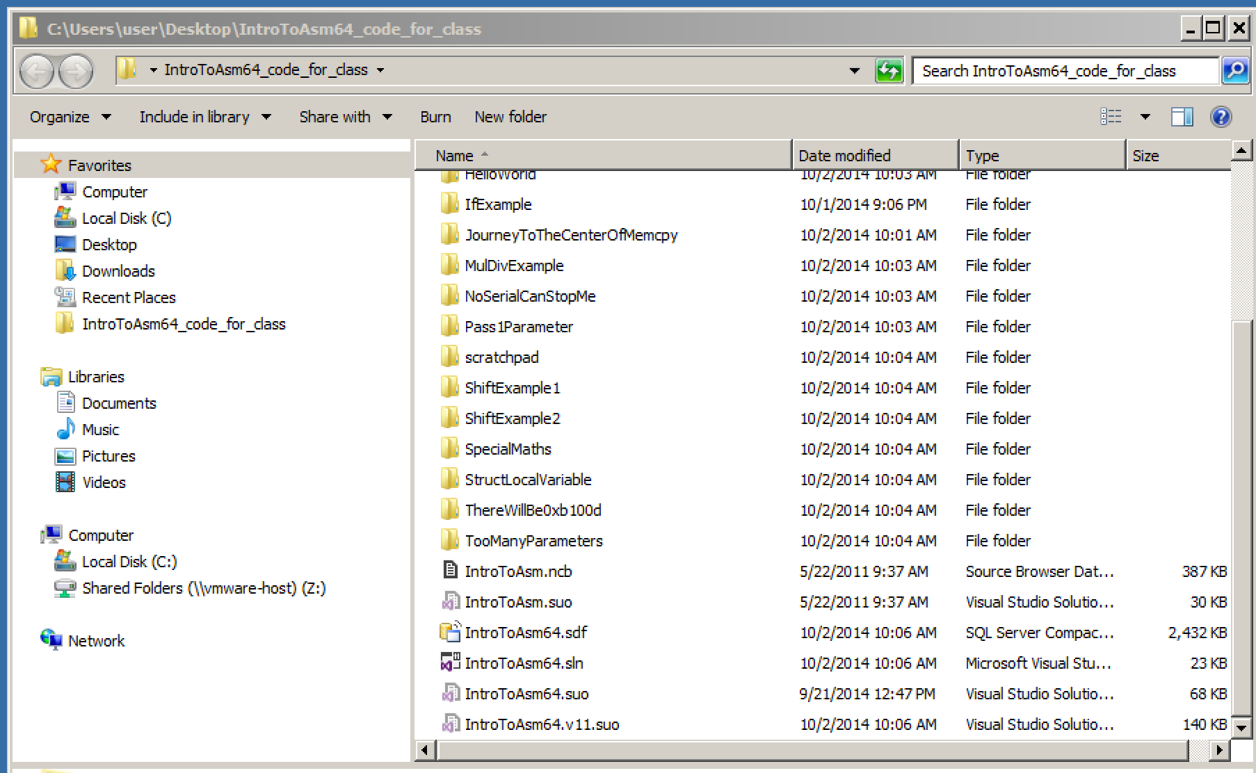
Open IntroToAsm64.sln

Slide 21
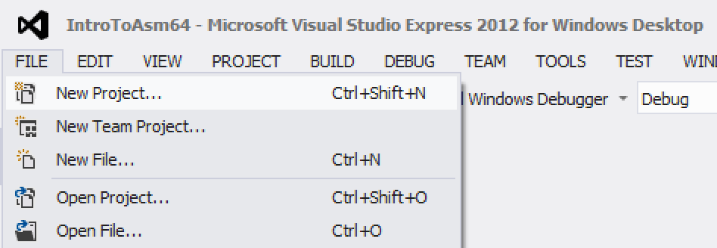
Creating a new project - 1

Slide 22
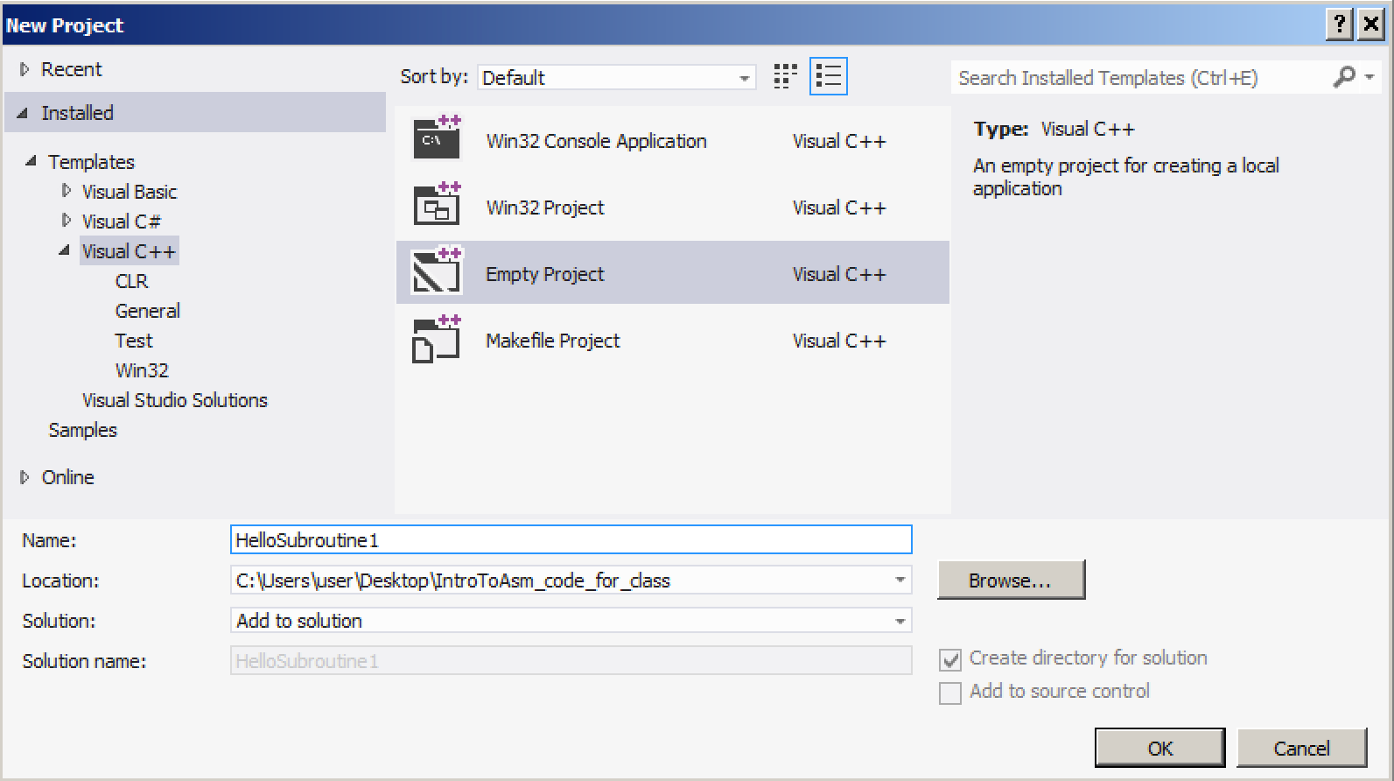
Creating a new project - 2

Slide 23
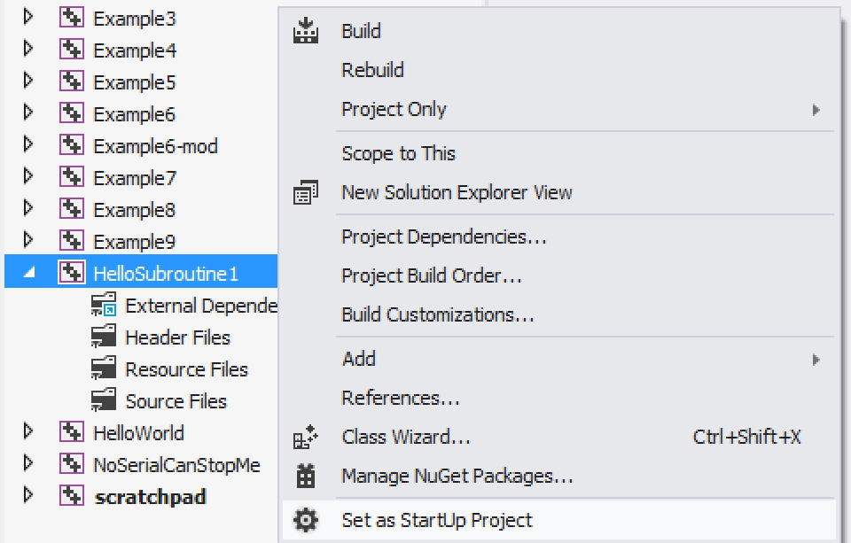
Creating a new project - 3
Creating a new project 3

Slide 24
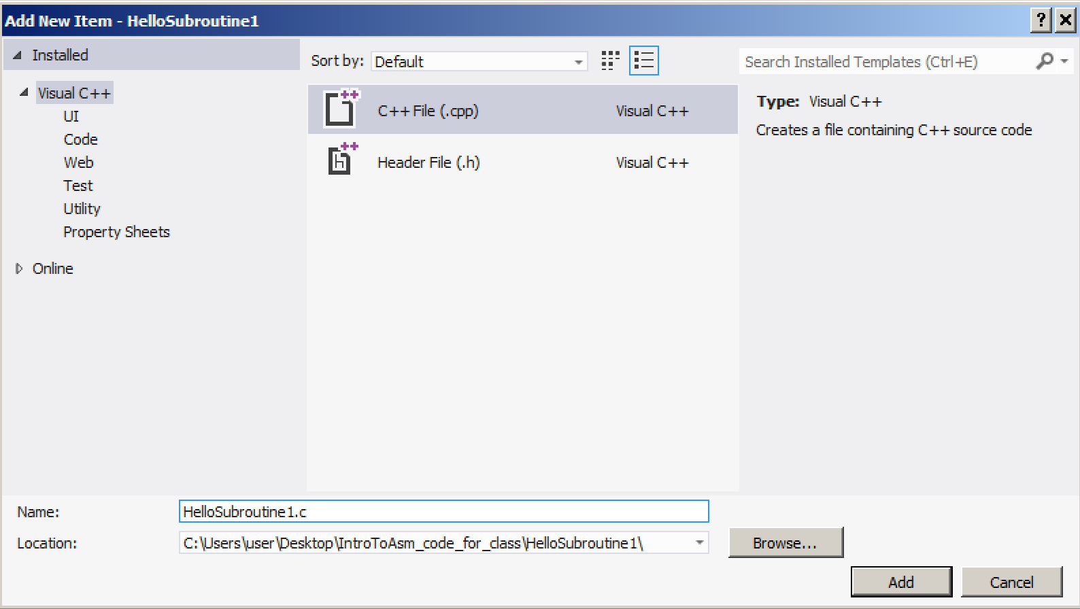
Creating a new project - 4
Adding files to the project

Slide 25
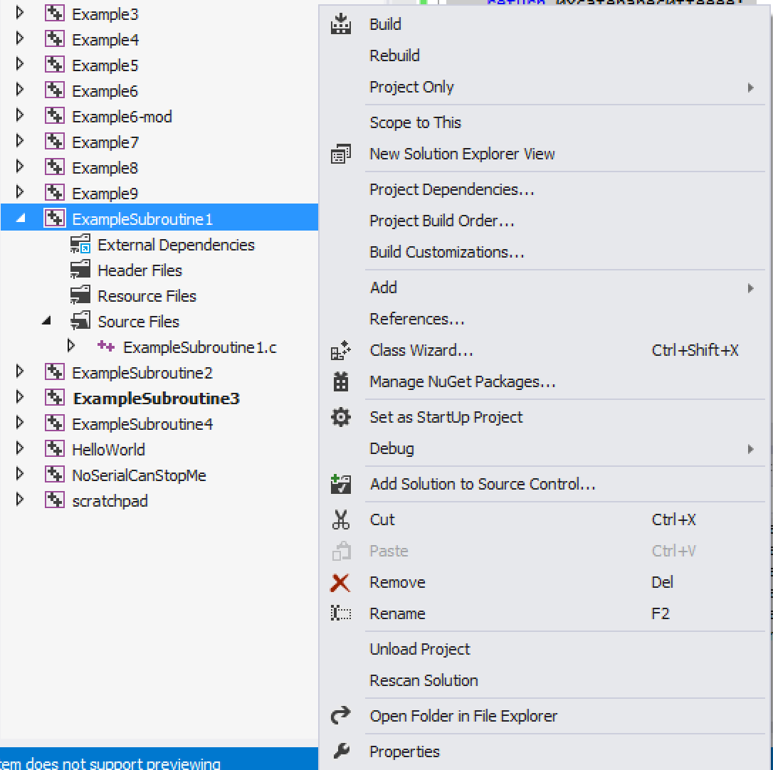
Setting project properties - 1
Setting project properties

Slide 26
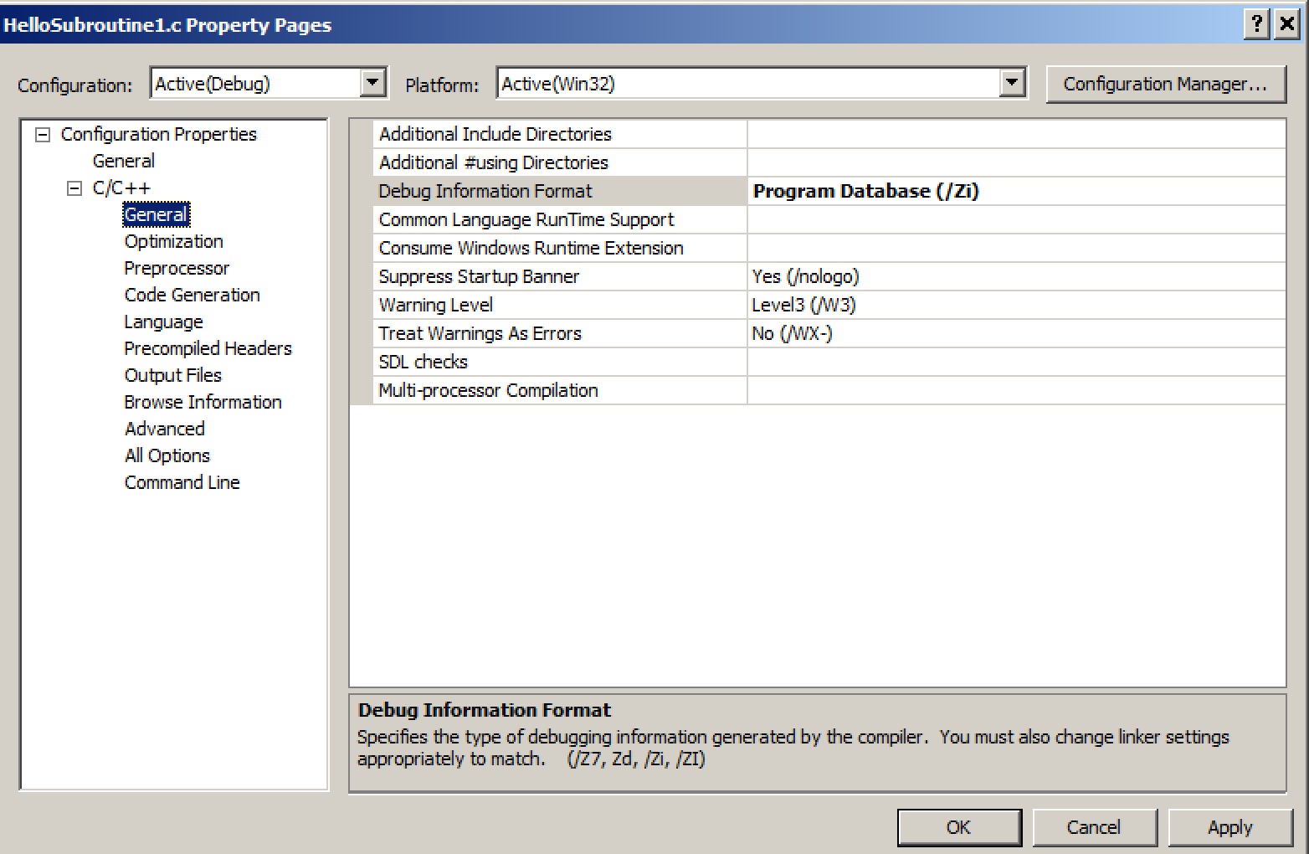
Setting project properties - 2
Setting project properties 2
Unfortunately the debug information format alters the code which gets generated too much, making it not as simple as I would like for this class.

Slide 27
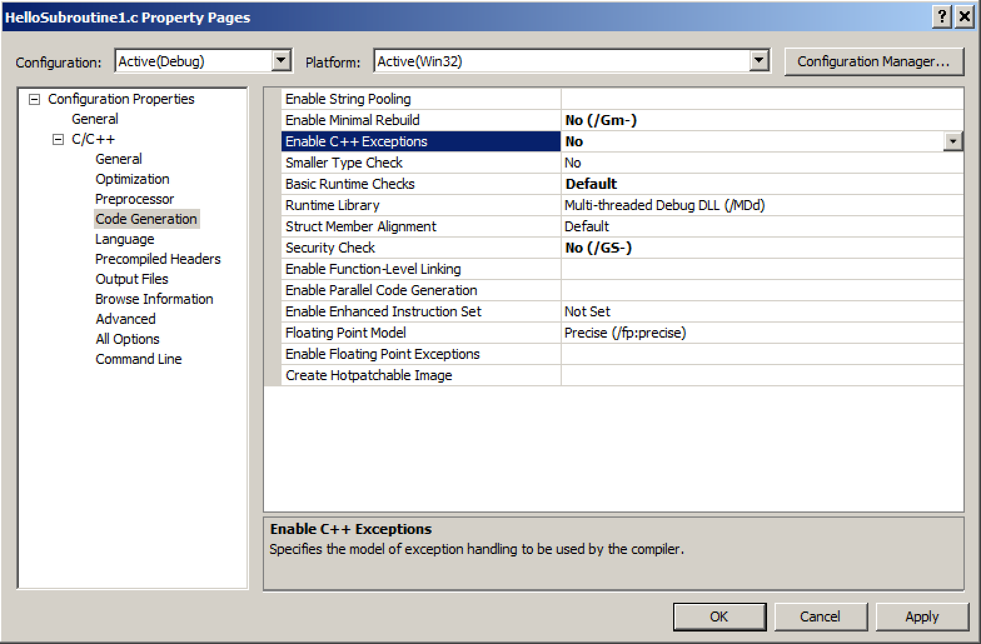
Setting project properties - 3
Setting project properties 3
These would just add extra complexity to the asm which we don’t want for now

Slide 28
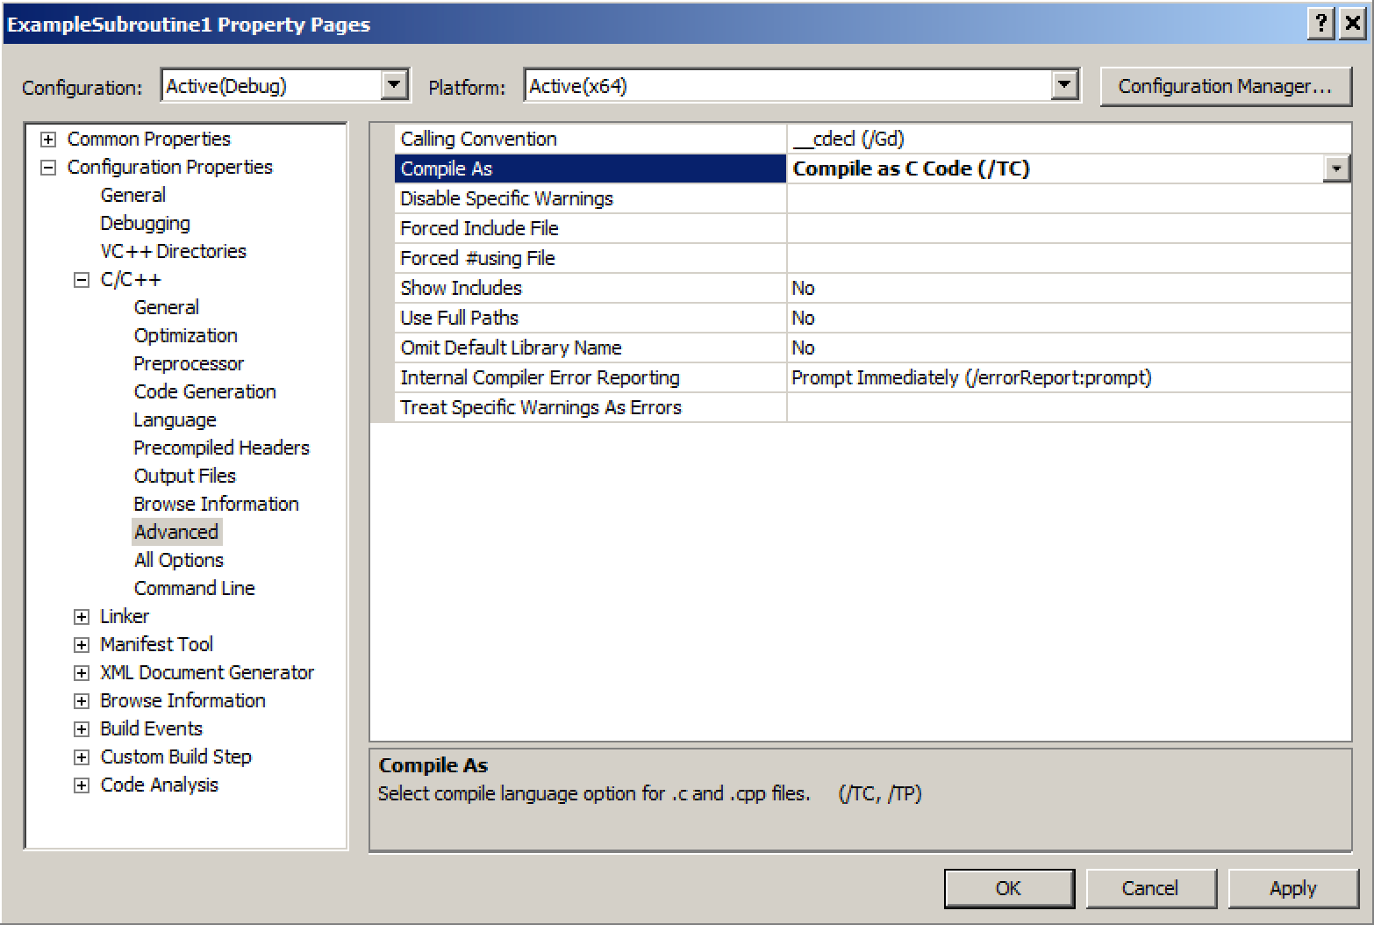
Setting project properties - 4
Setting project properties 5
This shouldn’t matter, but setting it just incase…

Slide 29
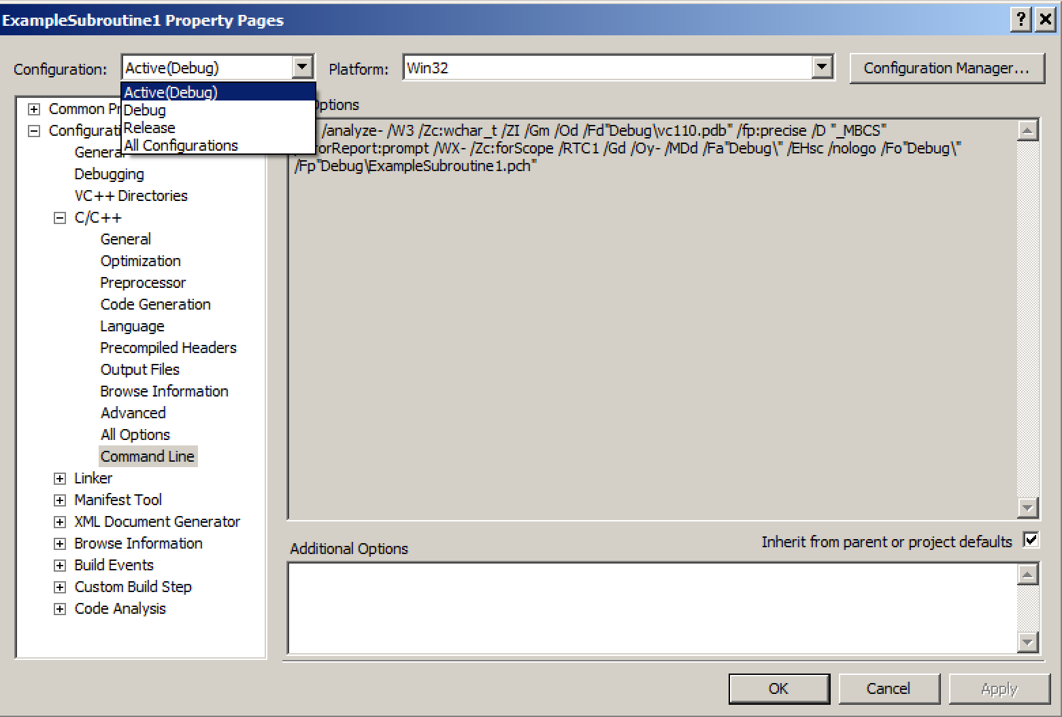
Setting project properties - 5
Setting project properties 4
Click this to change which config set is active
The GUI is just a wrapper to set command line options
Different options can be set for release vs debug builds

Slide 30
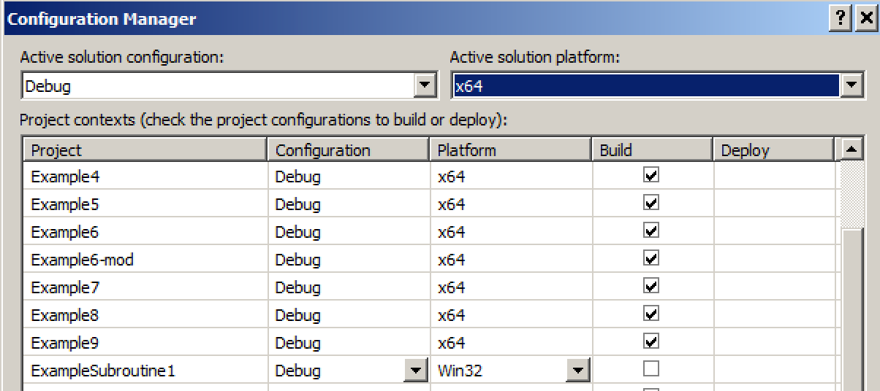
Setting project properties - 5.1
Click this to change which config set is active
Click this box
And then select “New” here

Slide 31
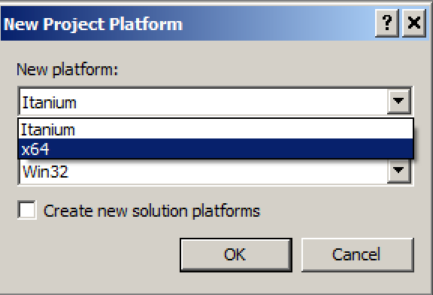
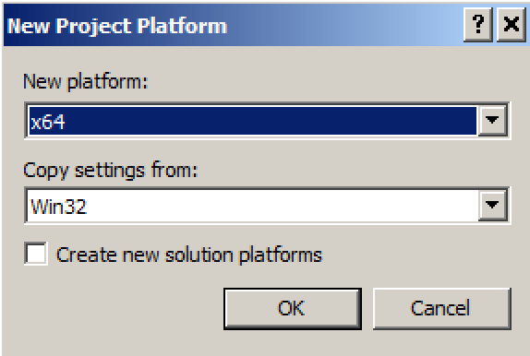
Setting project properties - 5.2
Pull down to select x64 build platform option
Once it’s selected, hit OK

Slide 32
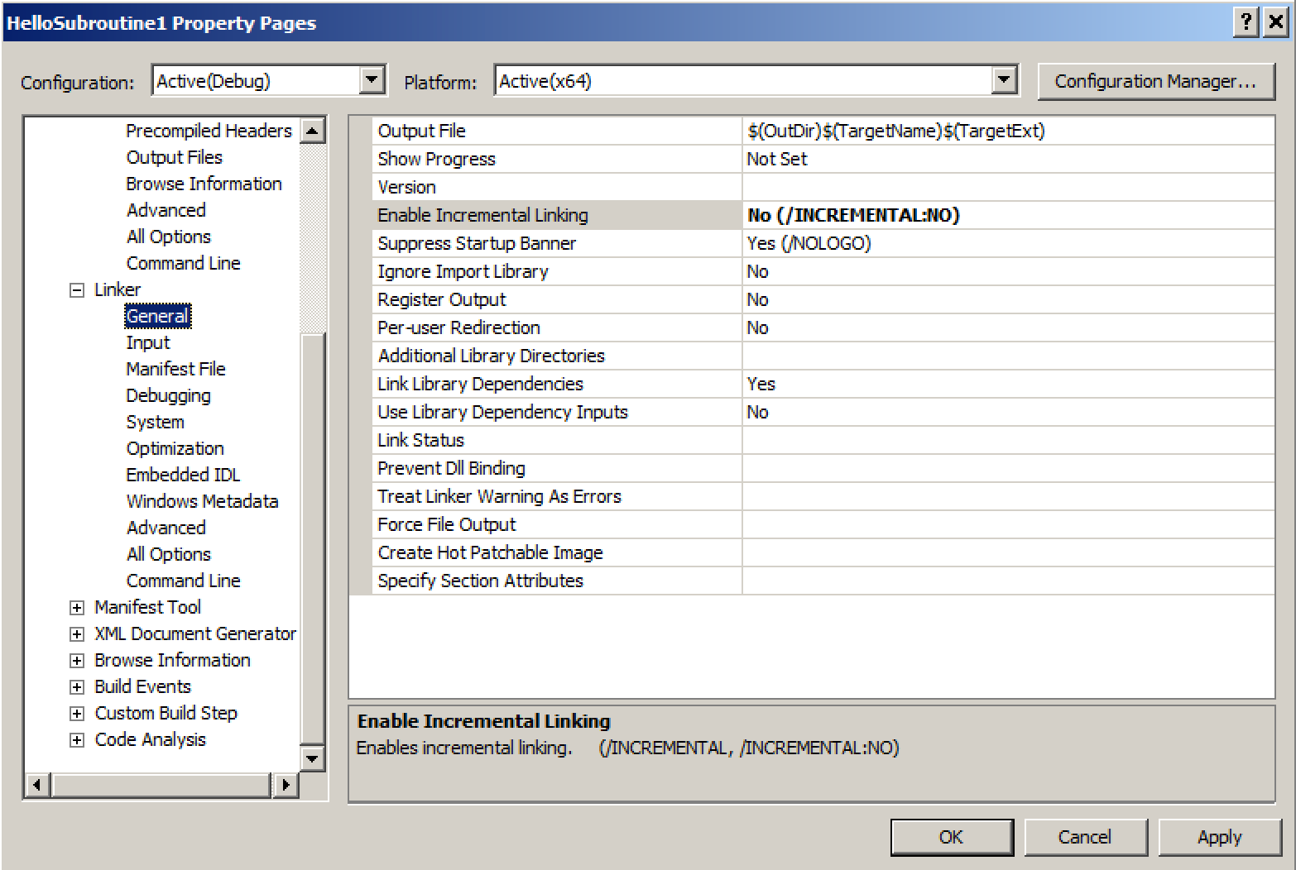
Setting project properties - 6
Setting project properties 6
This adds an extra jump between a call and the target function
83

Slide 33
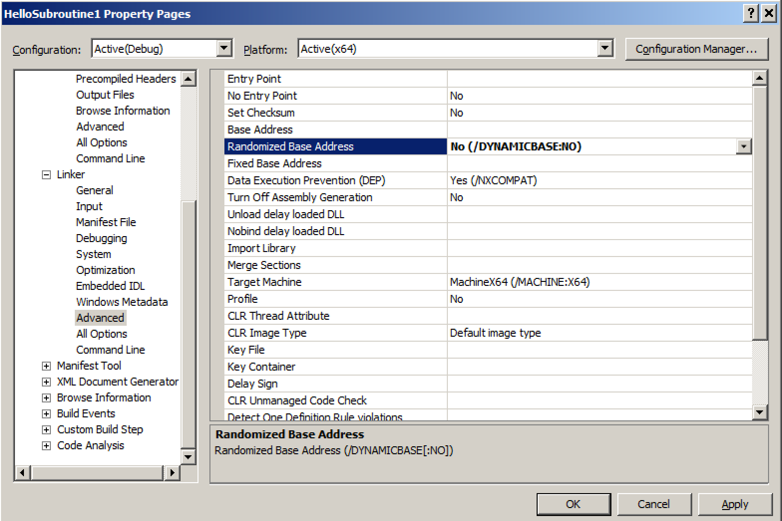
Setting project properties - 7
Disable Address Space Layout Randomization (ASLR) so that we see the same addresses in our labs

Slide 34
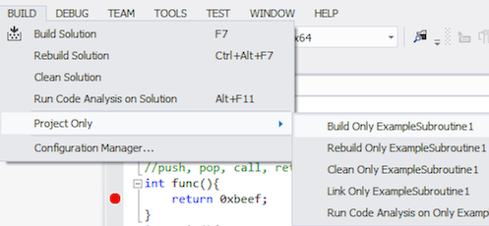
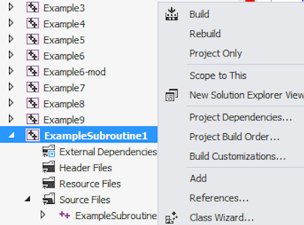
2 ways to build the project
Right click on project
and select build
Or select Build Only … from the
menu bar

Slide 35
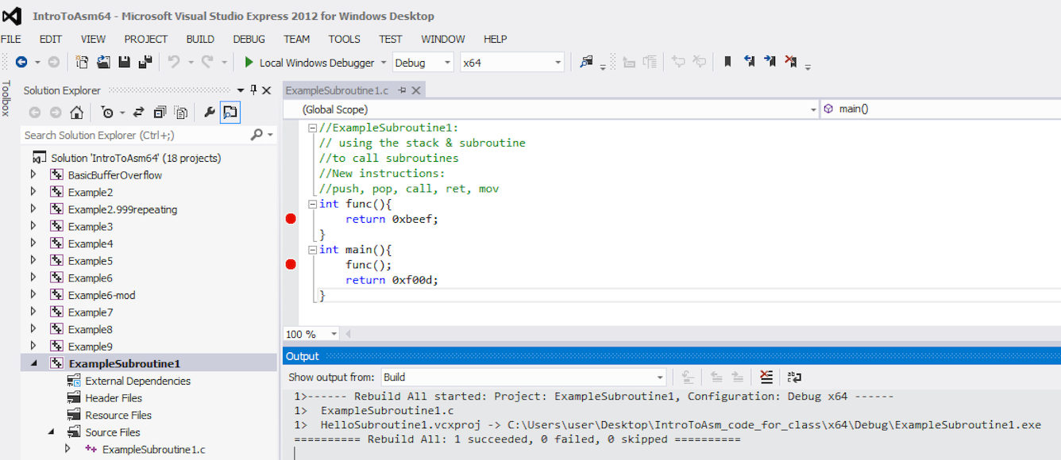
Building the project - 2
Information about whether the build succeeded will be in the Output window. If it fails, a separate Error tab will open up

Slide 36
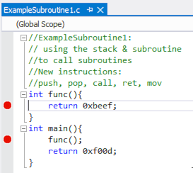
Setting breakpoints & start debugger
Click to the left of the line to break at.
A red circle will appear
86

Slide 37
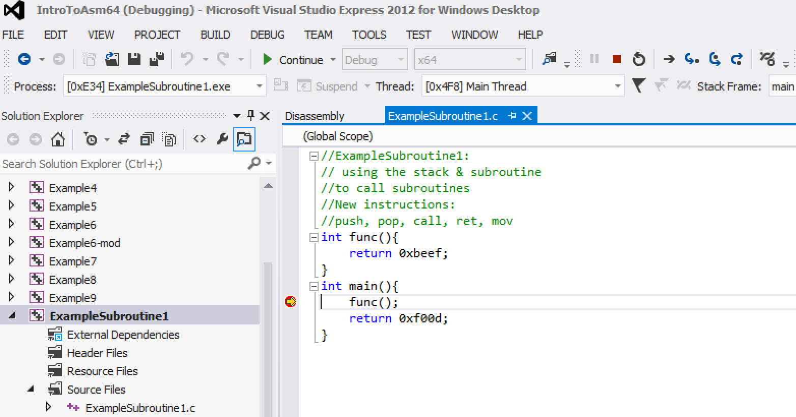
Debugging interface
Step
over
Step
into
Step
out
Debugging the program 2
Continue
Stop debugging
Restart debugging
Current stopped location

Slide 38
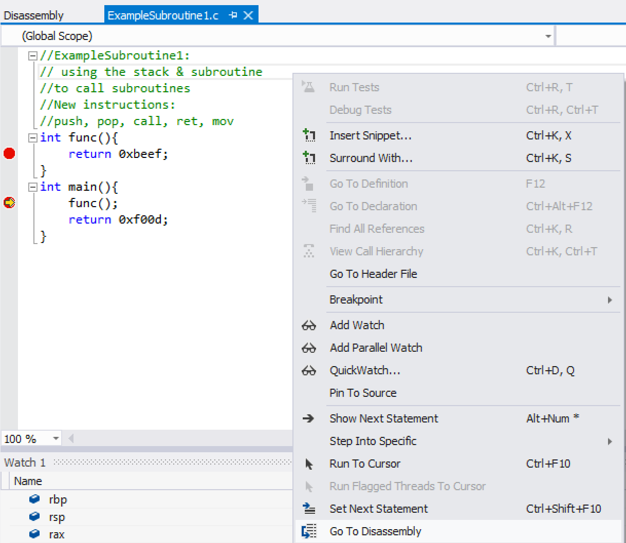
Showing assembly
Current stopped location
Right click: Only available while debugging

Slide 39
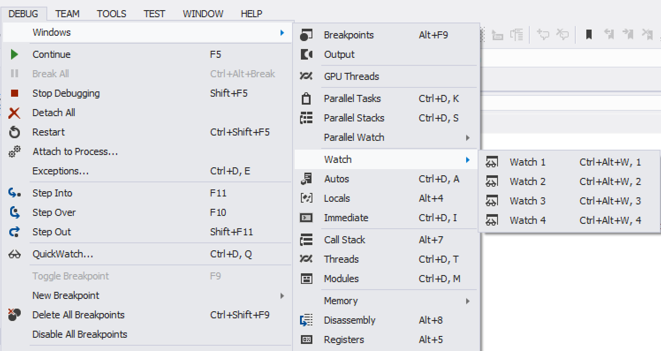
Debugging window options

Slide 40
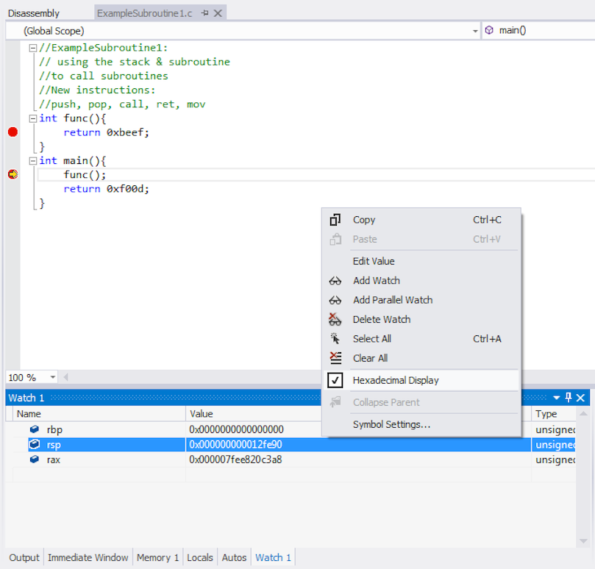
Watching registers (“watch”)
In the “Watch” tab you can enter register names or variable names

Slide 41
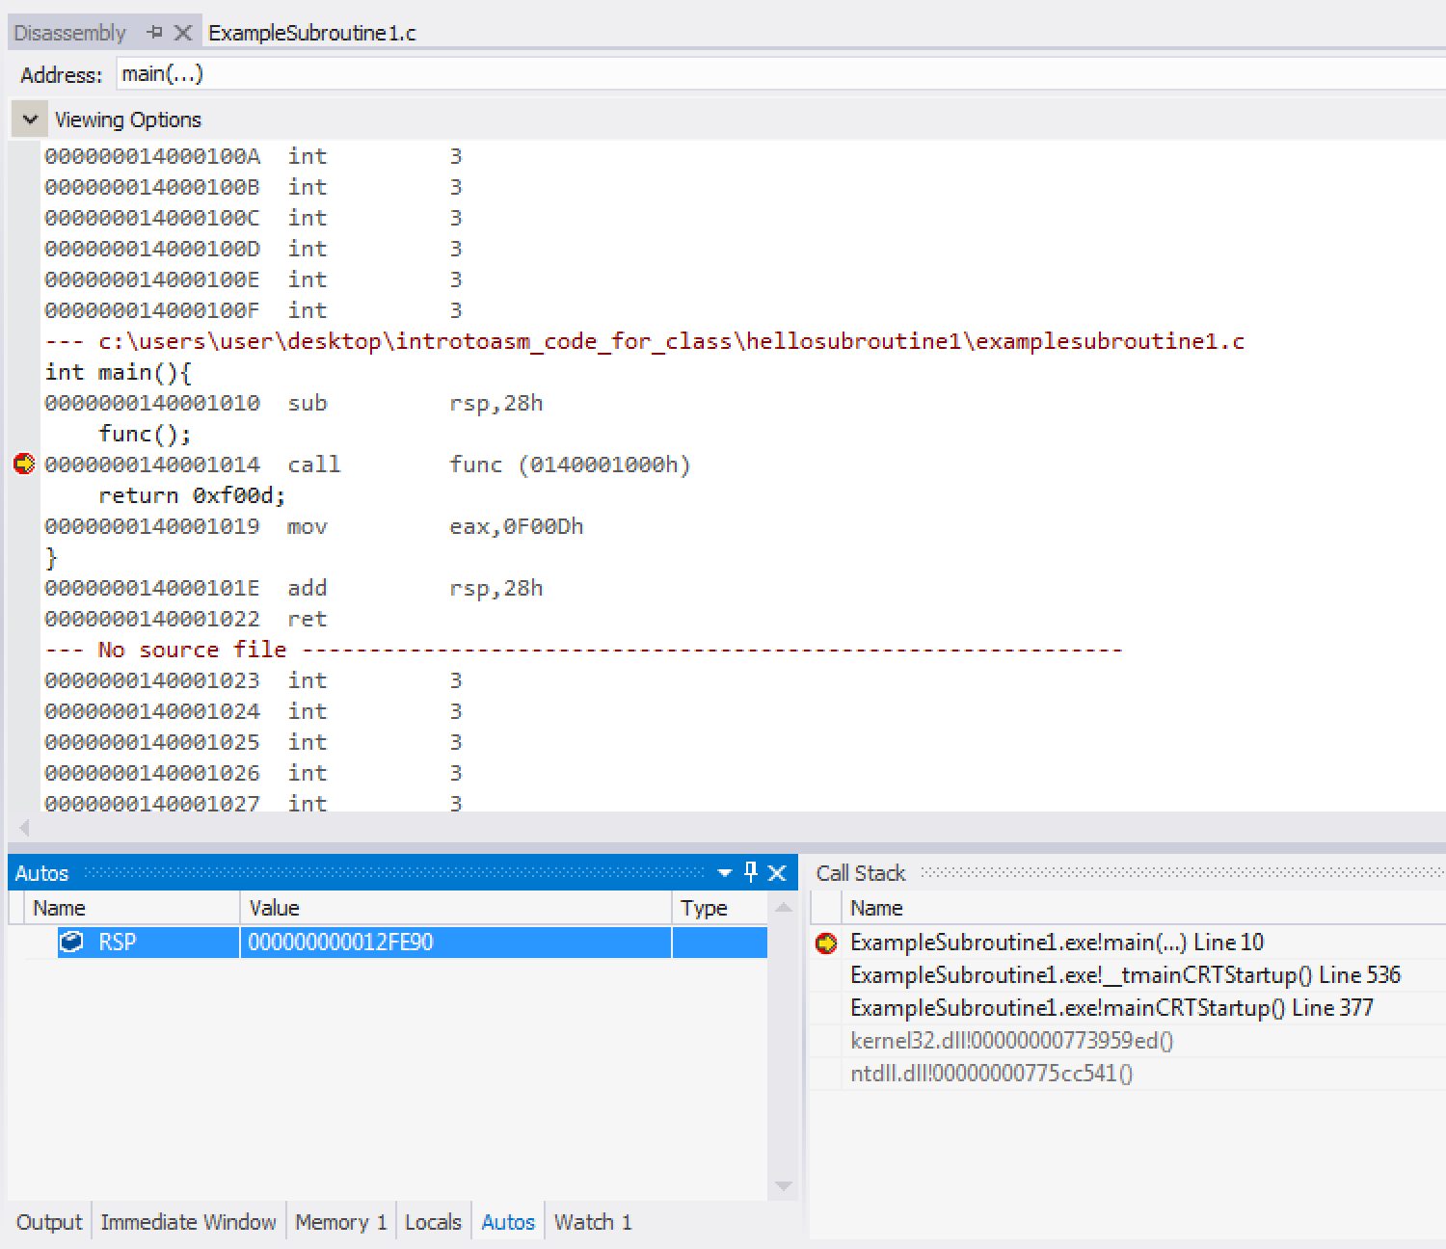
Watching registers (“autos”)
Note that it knows the RSP register is going to be modified by this instruction
Autos tab

Slide 42
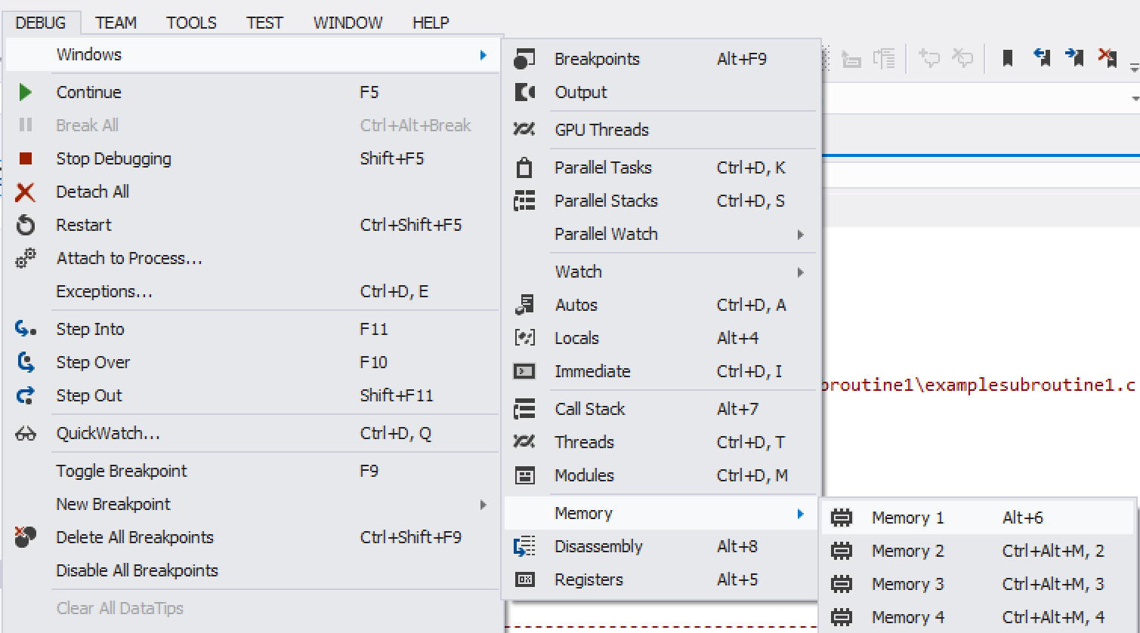
Watching the stack change - 1
Watching the stack change 1

Slide 43
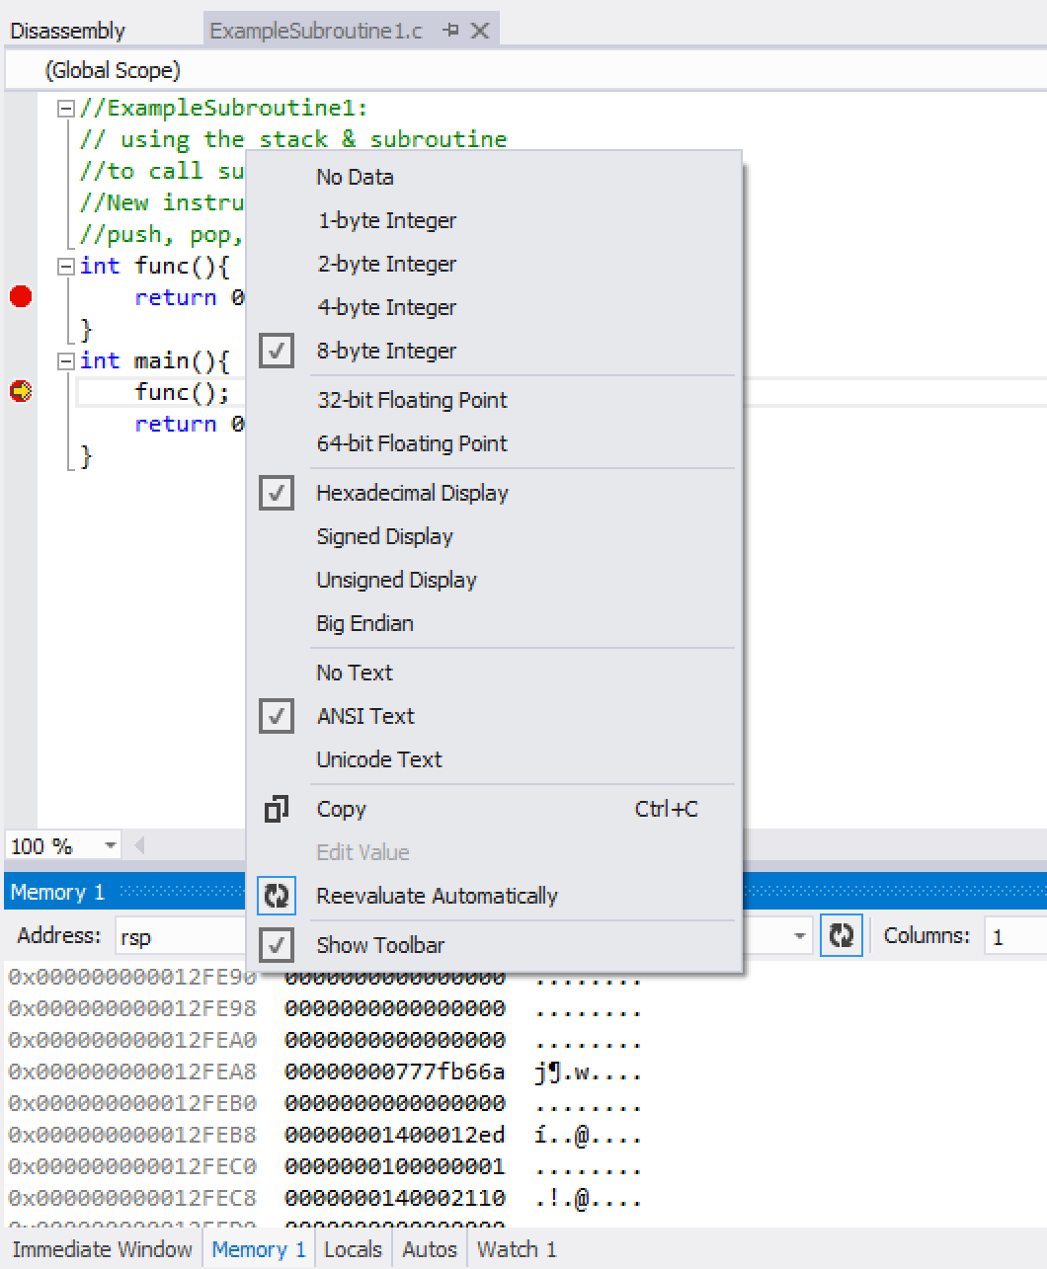
Watching the stack change - 2
Set to 8 byte
Set address to rsp (will always be the top of the stack)
Set to 1
Right click on the body of the data in the window and make sure everything's set like this
Click “Reevaluate Automatically” so that it will change the display as rsp changes
92

Slide 44
ExampleSubroutine1.c takeaways
Calling functions lead to an allocation of space on the stack, within the function where the variable is scoped to
In VS (when optimization is turned off), there is an over-allocation of stack space as a result of calling a function
0x28 reserved with no apparent storage of data on the stack
More about this later once we start passing function parameters
int func(){
return 0xbeef;
}
int main(){
func();
return 0xf00d;
}
func:
0000000140001000 mov eax,0BEEFh
0000000140001005 ret
main:
0000000140001010 sub rsp,28h
0000000140001014 call func (0140001000h)
0000000140001019 mov eax,0F00Dh
000000014000101E add rsp,28h
0000000140001022 ret

Slide 45
Instructions we now know (8)
NOP
PUSH/POP
CALL/RET
MOV
ADD/SUB

